Slide 1


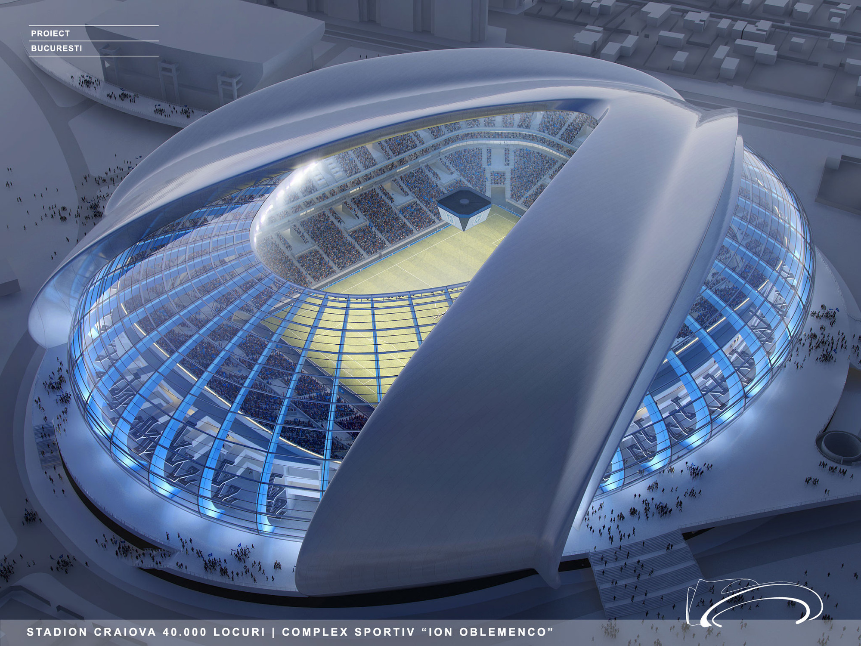

Product Design A LEVEL
The Sixth Form
Why study Product Design?
A designer dreams of things that never were, and says, ‘why not?’ Dick Powell
Practically everything you use, see and touch in a day is designed by someone. So, design is key to everything out there, be it architecture, furniture design, electrical products, toys, fashion, packaging, graphics, jewellery or anything else manufactured. Designers hold a pivotal position in society as they determine the success or failure of every product and how it impacts on the consumers who use them. In today’s society, designers also have a great responsibility to meet the demands of the new millennium and consider ethical issues such as the environment, designing for need and providing for the developing world. If you love innovation and think why not! then this is the course for you.

Slide 2
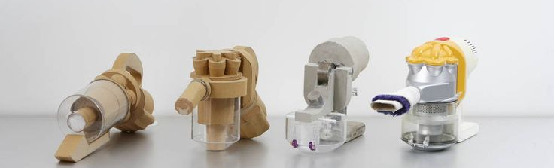
Product Design A LEVEL
The Sixth Form
What are the lessons like?
Lessons are very varied with something for everyone. The first term will be skills-based to teach you the designing and making skills needed for successful completion of the coursework. This will include design communication incorporating CAD, analysis skills and problem-solving strategies. We do some focussed theory lessons but the majority of the time you will be in the workshop doing hands on research, designing, development, testing and manufacture. We do some team designing early in Year 12 but you will spend most of your time working, with support, on your individual design and make coursework assignment.
You will start your
course project in January.

Slide 3
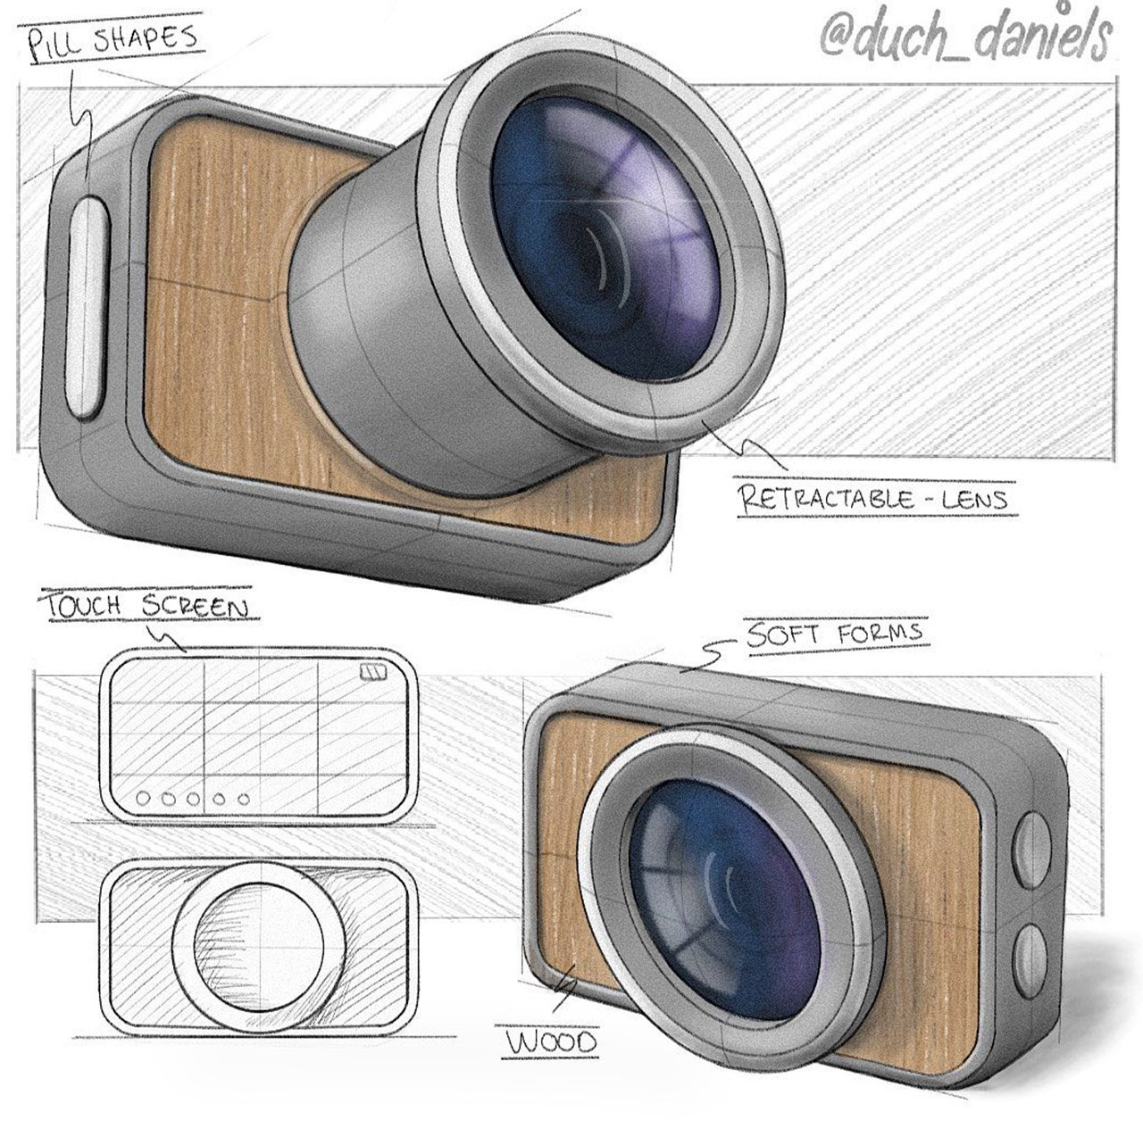
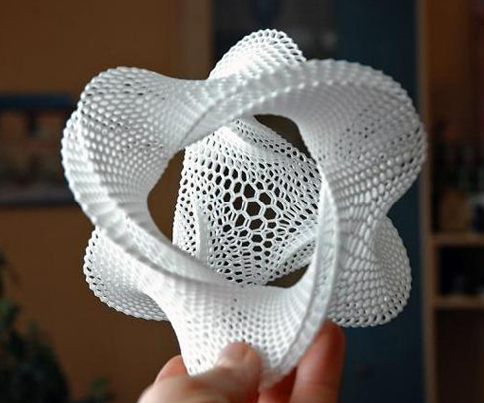
Product Design A LEVEL
The Sixth Form
Skills and development:
Independent use of machinery and the workshop space;
modelling skills;
Testing and experimenting;
CAD design;
Sketching and rendering;
Research and presentation skills;
teams work – independent study;
3D printing – laser cutter;
Metal lathe and hand tools.

Slide 4
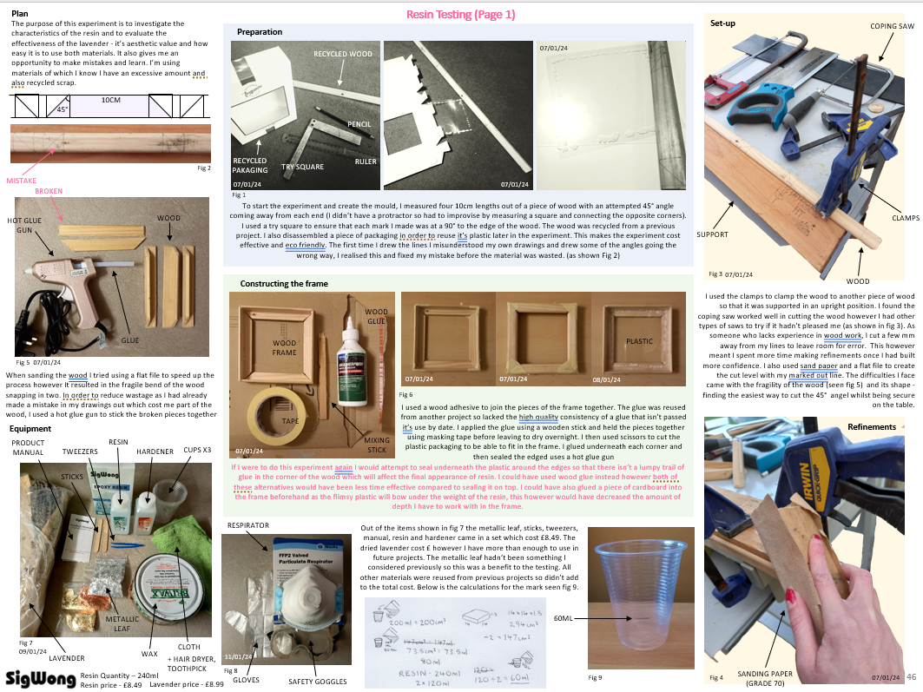
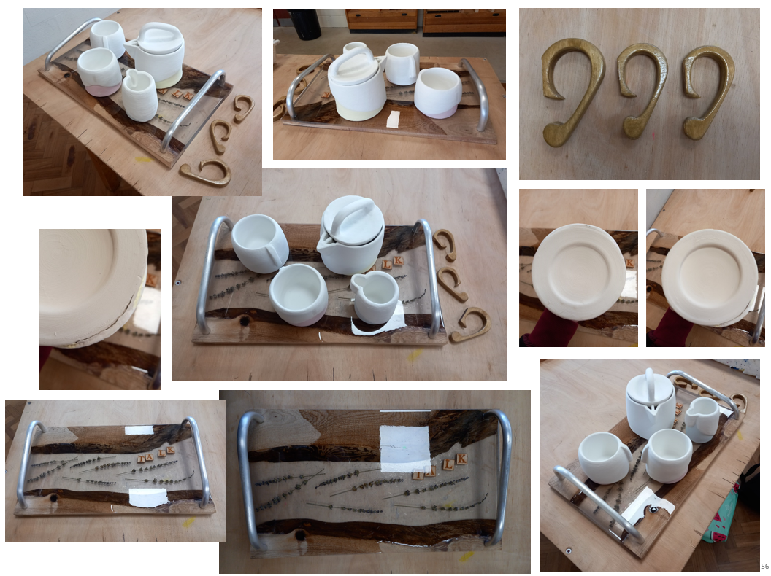
Product Design
The Sixth Form
What will you be learning?
At A level, 50% of the assessment is through a ‘Design and Make’ assignment. Together, we will come up with a range of contexts for you to explore. You will use a design process similar to the structure of your GCSE Technology course to design and manufacture a prototype product. In previous years, themes such as ‘mental health’, ‘seating design’, ‘children’s educational toys’ and ‘design for disability’ have been popular.
You will start with a problem, and work through research, design work, modelling and development to create an innovative design solution. This will be manufactured as a high-quality product solution and then evaluated and tested. The remaining 50% is assessed through a written exam paper where you will be tested on your understanding of the social context and theory of designing and manufacturing. The content of the exam will be weaved into the design and make projects in Y12 and the controlled assessment coursework through both Y12 and Y13.

Slide 5

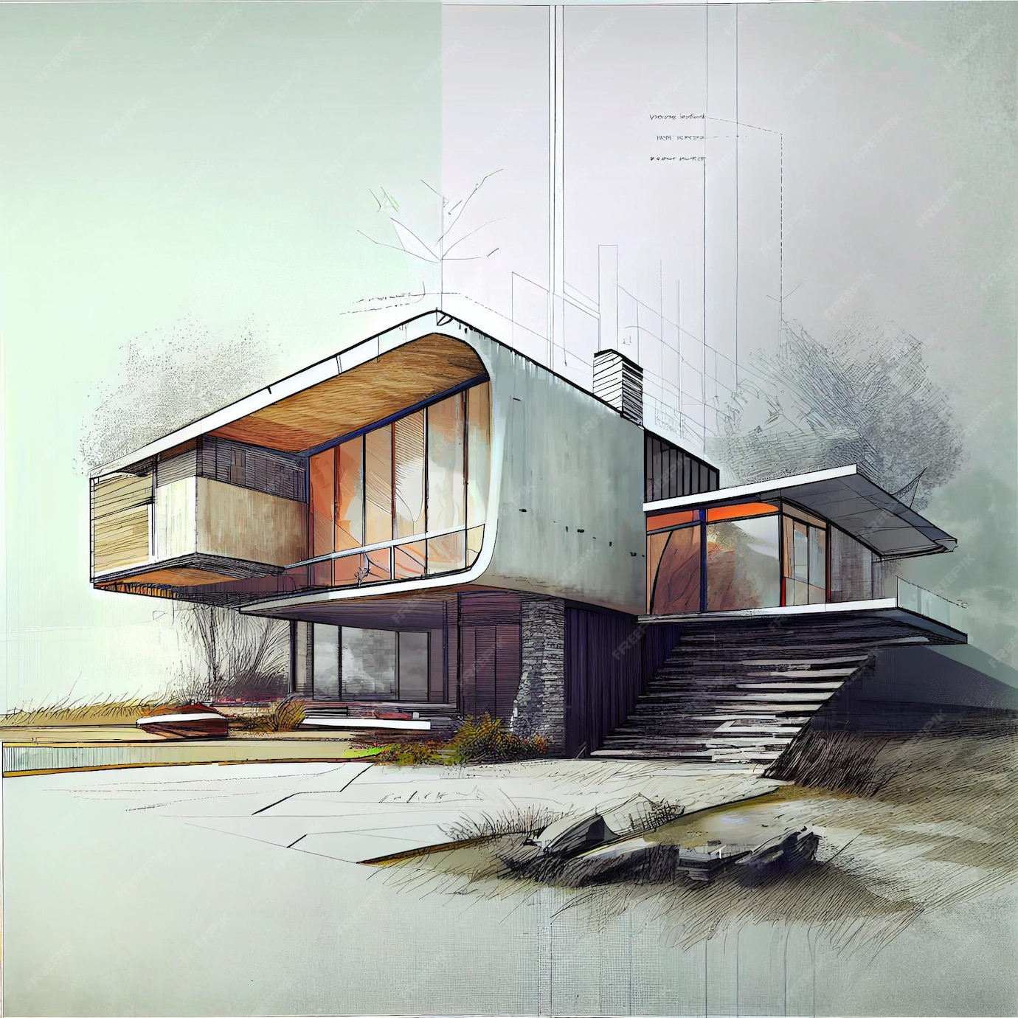
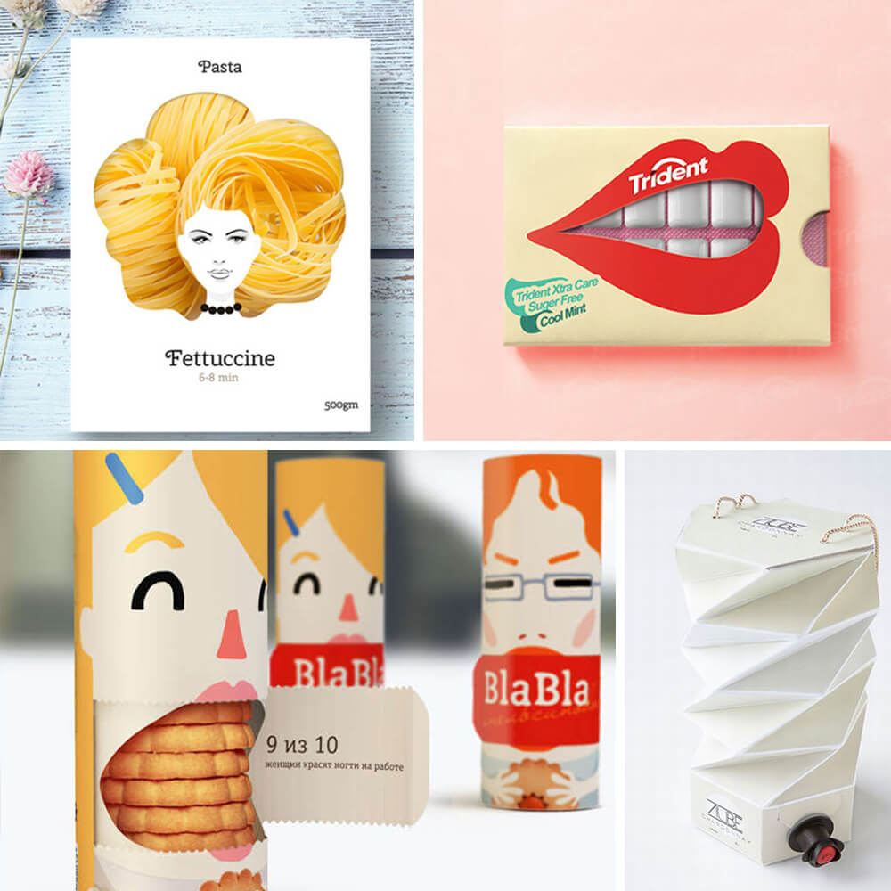
Product Design A LEVEL
The Sixth Form
What can it lead to?
Because Product Design is such a wide topic it can lead to many different options after A Level. The obvious progression is to study a degree course in product or industrial design, engineering, architecture, interior design, graphics or one of the huge range of ‘designing’ courses now available. Alternatively, you might want to pursue a career in teaching, take up an apprenticeship, or train as a design technician or craftsperson.

