Slide 1
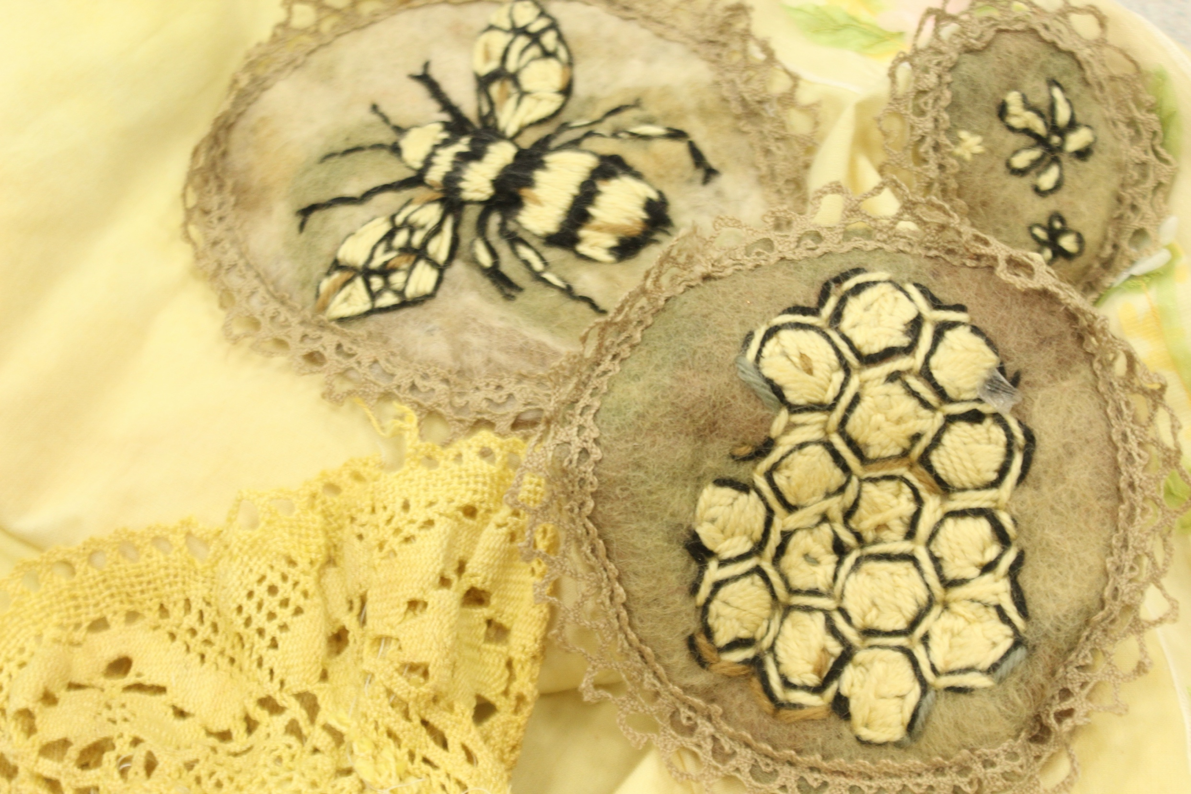
Fashion / Textile Design A Level
Objectives and aims
To understand what Fashion / Textile Design is all about and why you should consider studying it.
To be aware of the subject content that you will study in the first year and the skills you will need to develop during this time.
To be aware of where it might lead you in terms of careers and future opportunities.
Thank you to all our A Level Fashion/Textile Design students for their amazing textile work on these slides!

Slide 2
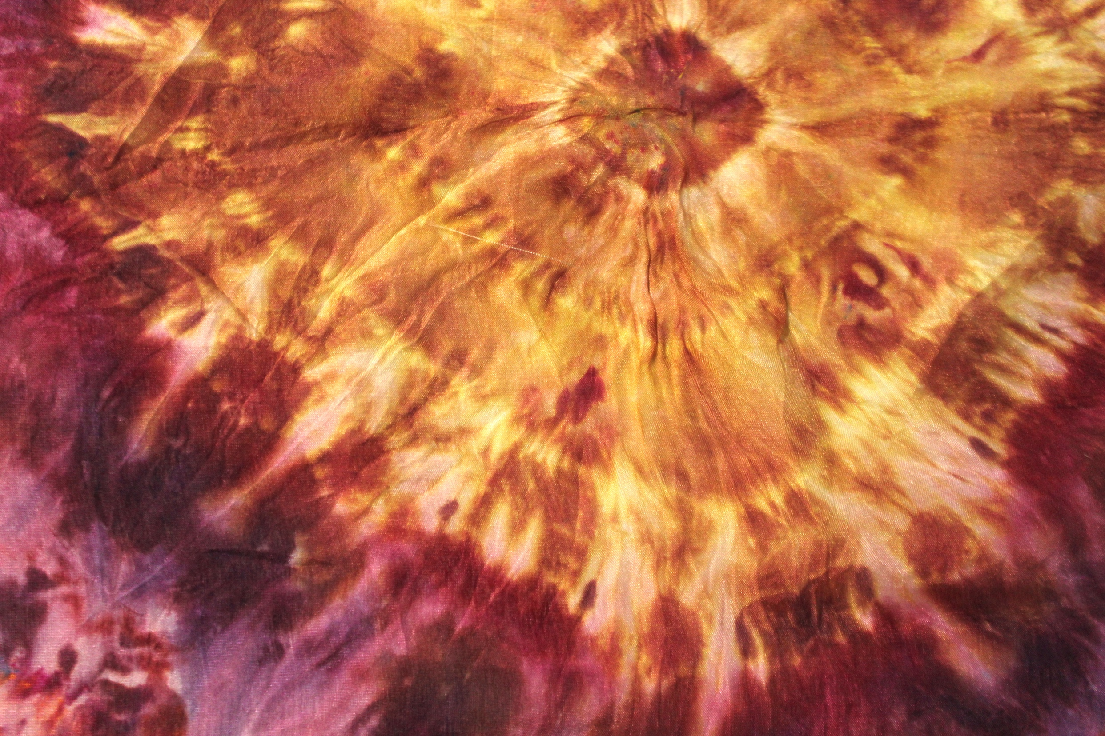
What is Fashion / Textile Design?
What will I study?
Textile design is the creative process of creating and planning the appearance and structure of fabrics. Textile designers create patterns and designs for fabrics used in clothing, soft furnishings, and other industries. They consider how the yarns and materials are put together to create the fabric's structure, which affects how it looks, feels, and lasts. Textile designers use a variety of techniques to create fabrics, including dyeing, weaving, knitting, printing, and embroidery.
Fashion design is the creative process of designing clothing and accessories for consumers. It involves a combination of artistic skill, technical knowledge, and storytelling to create exciting wearable art that reflects current fashion trends.
A level Fashion (Textile Design) allows you to develop an exciting and extensive range of creative and technical skills. You will also gain a strong understanding of historic and contemporary visual art practice, through supporting contextual studies. Unique to studying Fashion (Textile Design) at A Level, you build up a very personal and continually evolving body of practical work, guided and supported by your teachers. Individual exploration and development of your personal skills and creative directions is a special aspect of this subject.

Slide 3
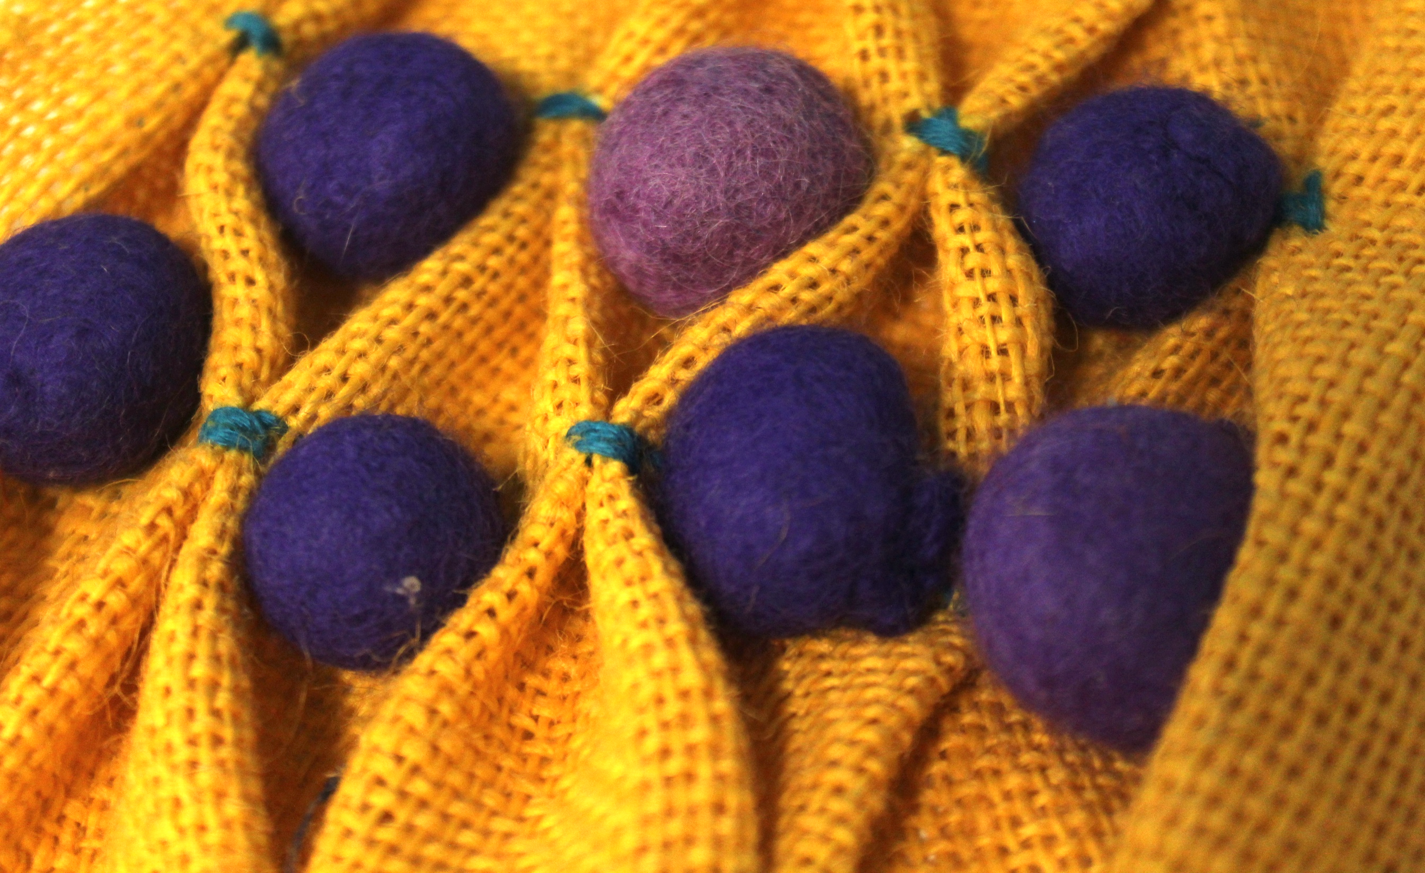
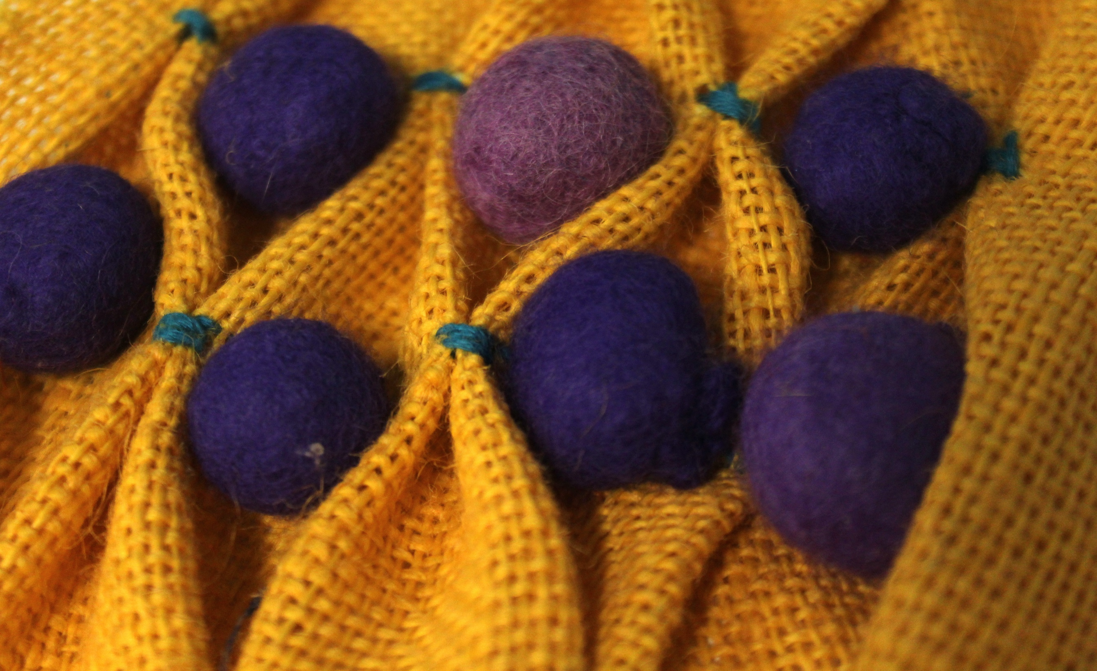
Why study Fashion (Textile Design)?
There are many reasons to study Fashion Design, including:
Creative expression: Fashion design is a hands-on way to express yourself creatively. You can learn how to use materials and accessories to create garments that people will love to wear and look at;
Gaining skills: You can learn a variety of subject specialist skills, including pattern making, cutting, hand and machine sewing, fabric printing and craftsmanship;
Working in a competitive field: Fashion Design is a sought-after field that offers interesting challenges and the opportunity to meet creative people;
Making an impact: You can use your skills to make a positive change in the world. For example, you can learn how to make the fashion industry more sustainable;
Students learn to problem solve throughout the course;
The course helps develop strong analytical and professional presentational skills;
Students learn how to record the progress of their work and present it effectively to a viewer;
All these transferable skills are very attractive to a wide range of employers and the ability to 'think outside the box’ is considered valuable in a whole spectrum of professions. Students create individual portfolios of textile and design work based on their interests and areas of expertise;
Fashion (Textile Design) A level is recognised as being on a par with the most academic A levels because of the emphasis it places on research, conceptual depth and critical rigour;
Fashion (Textile Design) fits in well with many other A level choices.

Slide 4
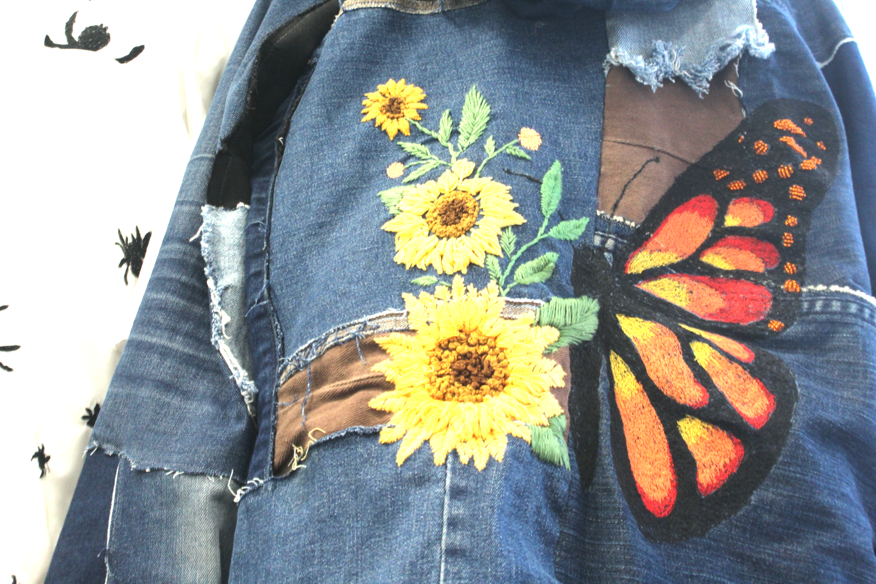
Skills developed during the course:
Studying A Level Fashion (Textile Design) can help you develop a broad and useful range of skills including:
Creative problem-solving: You'll learn how to develop creative solutions to problems;
Observational skills: You'll learn how to observe the world around you;
Thinking outside the box: You'll learn how to challenge your perceptions and come up with innovative ideas;
Research skills: You'll learn how to research and develop ideas;
Critical thinking: You'll learn how to develop critical opinions and demonstrate critical understanding;
Communication skills: You'll learn how to communicate your ideas visually and relate your work to other materials;
Time management: You’ll learn how to create a sustained and substantial portfolio over time;
Confidence: You’ll undertake extensive and sustained exploration of selected techniques, materials, media and processes;
Technical skill: You’ll develop advanced skills with selected techniques, materials, media and processes;
Reflection and self-awareness: You’ll develop the ability to review and refine work as it develops;
Literacy skills: You’ll focus on the quality of written communication and the use of specialist vocabulary, developing the ability to structure a written response and make connections between visual and other elements;
Presentation skills: You’ll develop the ability to select, organise and present work to meet all Assessment Objectives of the A Level course.

Slide 5
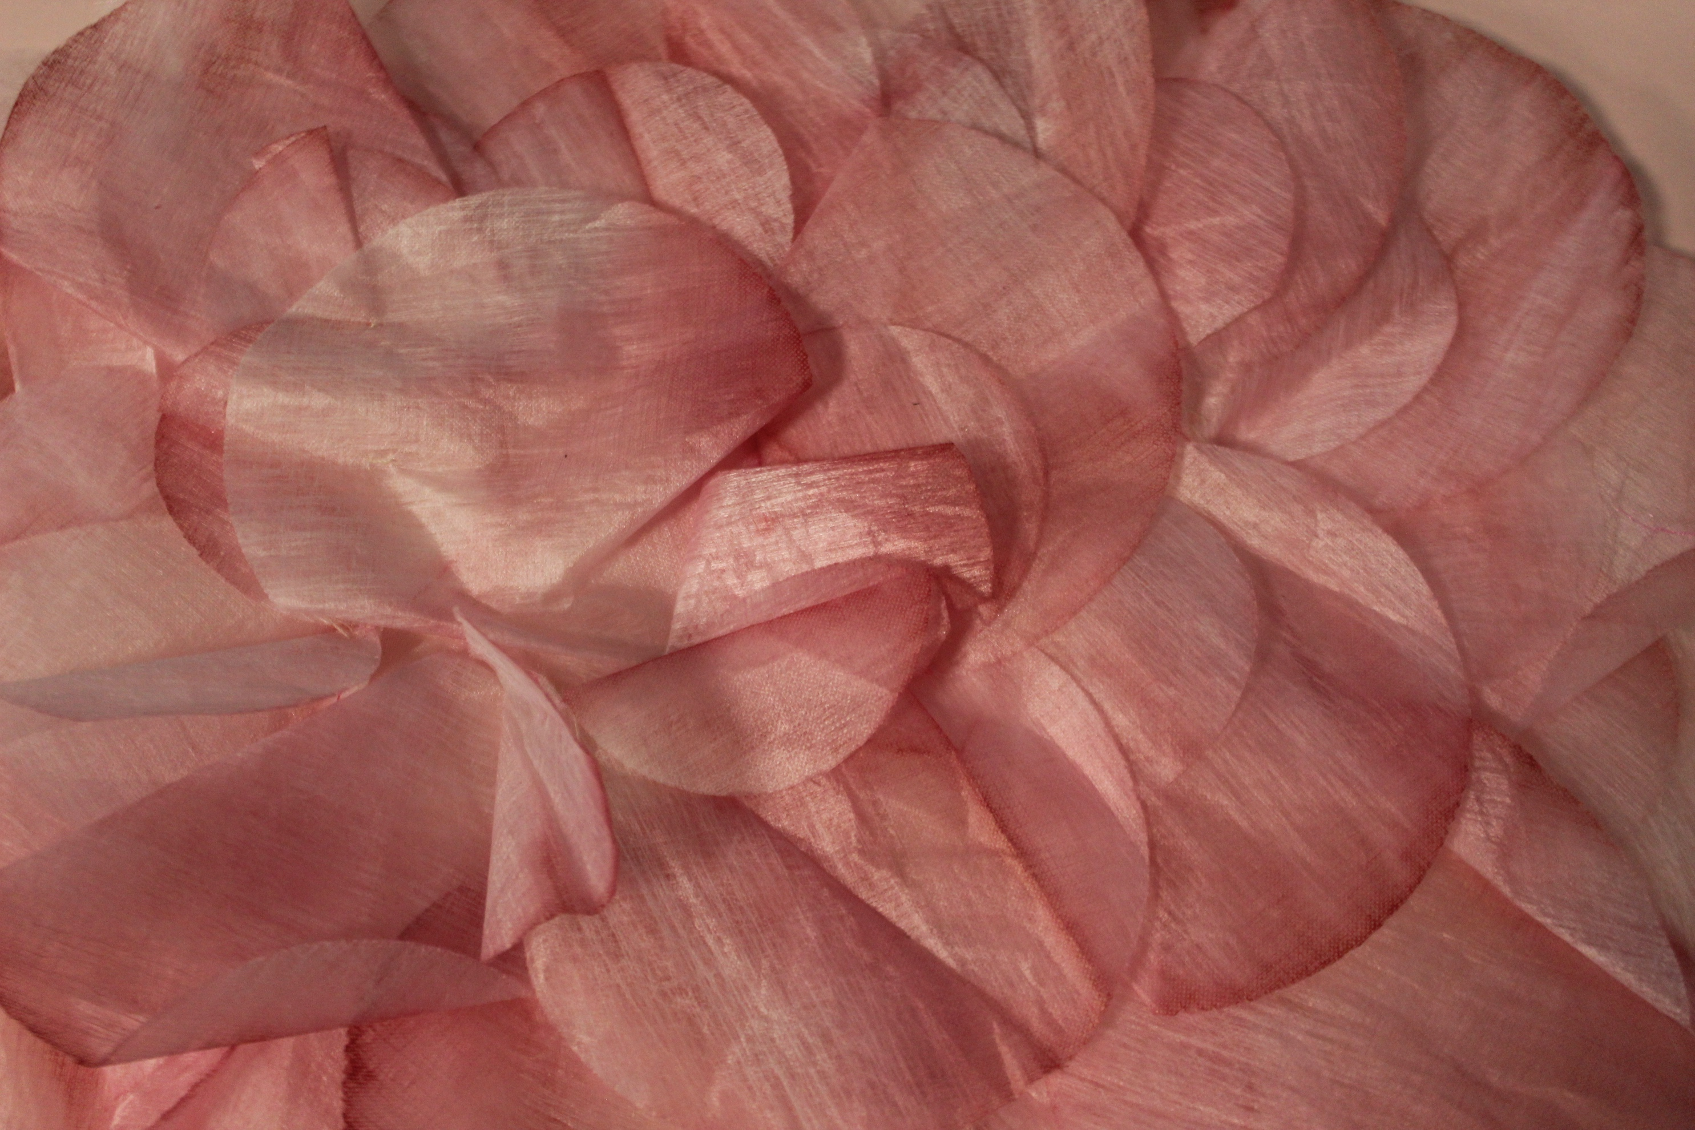
Subject content – first year of study
A Level Textile Design (H604, OCR exam board)
September – January
Developing Skills course
Not formally assessed
Topics include:
Pattern cutting;
Fabric dyeing and printing;
Hand and machine sewing;
Fabric manipulation;
Yarn-based techniques;
Embellishment;
Upcycling.
February of Year 12 – January of Year 13
Personal Investigation
Individual project
Students select own theme and specialisms
Practical portfolio of textile work in chosen specialisms
1000-3000 word Related Study
Formally assessed
Worth 60% of final A Level grade

Slide 6
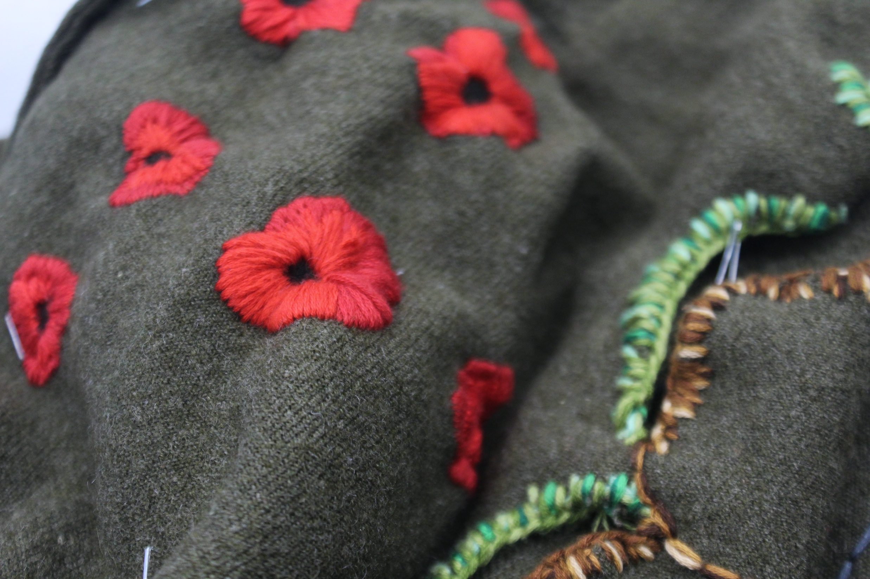
Where might A Level Fashion (Textile Design) lead me?
The creative and cultural industries express and reflect the importance of creativity and culture in our society. All around us, designers create the world we inhabit and contribute to a thriving and important industry which has a vast range of exciting career options and choices.
A strong creative training can also develop highly valuable transferable skills, including creative ideas development, problem-solving, contextual interpretation, and visual communication, as well as organisational, presentation, and team-working skills. These skills are valued by employers in many sectors.
A textile and fashion design course can lead to a variety of careers in the fashion and textile industry, including:
Fashion designer (in-house or freelance), pattern cutter, fashion stylist, fashion illustrator;
Buyer: Work as a buyer (a professional who selects and orders clothing and accessories for a company to sell to the public);
Visual merchandiser (a professional who designs and arranges product displays and store layouts to attract customers and increase sales);
Retail manager, design manager;
Product developer (a professional who is responsible for the creation, design and launch of new products);
Textile designer: Work for a design agency, retailer, or manufacturer, or become a freelancer;
Senior designer or production manager: Advance to a senior role at a design agency, retailer, or manufacturer;
College or university teacher: Teach textiles or art and design at a college or university;
Research department: Work in a research department for a company that develops technical textiles for aerospace, healthcare, or sports equipment;
Trend forecaster or creative consultant: Work in trend forecasting or creative consultancy to help ensure products and services are relevant;
Other employers of textile design graduates include small specialist design companies, interior design and decoration services, and private clients.

Slide 7
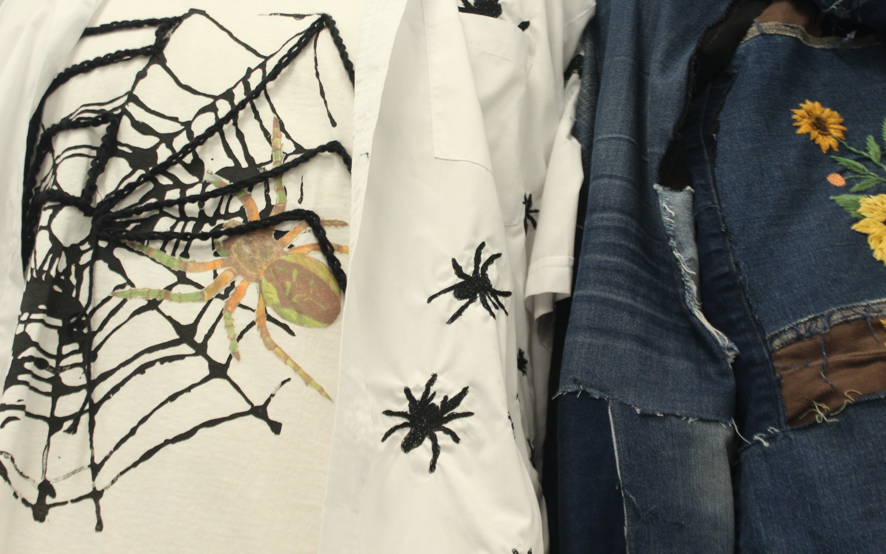
What students say about the course:
“I have always wanted to do it.”
“I’ve gone from being scared of big projects to making a lot of big garments.”
“I would recommend the course 100% - there’s so much creative freedom and expression.”
“I found having a creative outlet at Sixth Form has really helped me.”
“I would 100% recommend the course as the learning support and personal progress is completely different and amazing compared to other subjects.”
“I am improving my independent learning.”
“Time management, independence, practical skills and creative development will all help me in my future studies at uni.”

Slide 8

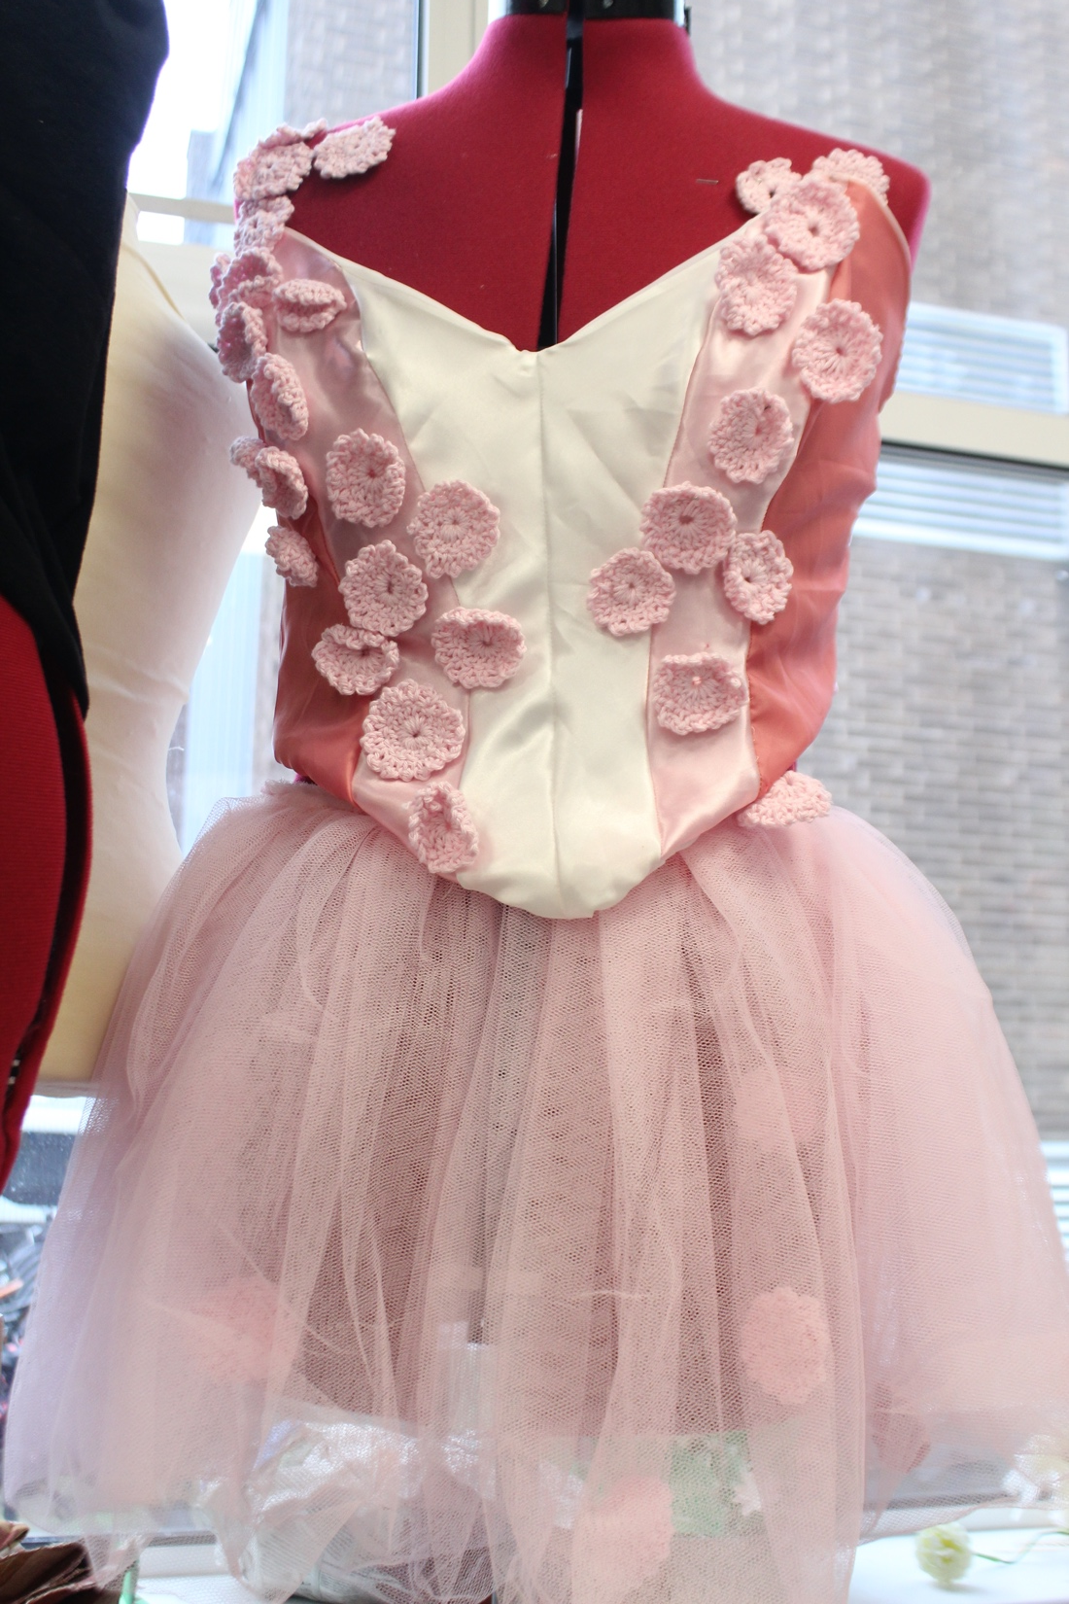
Assessment
All work is marked internally by teachers and moderated externally by the exam board.
Component 1: Practical Portfolio and Related Study (the Personal Investigation)
Worth 60% of the final A Level grade
Students produce a portfolio of visual work in response to a theme of their own choosing, supported by a 1000-3000 word Related Study.
Students make a final personal response with no time limit within the duration of the project.
Component 2: Externally Set Task
Worth 40% of the final A Level grade
Students produce a portfolio of visual work in response to a theme set by the exam board.
The Externally Set Task runs from February to May of Year 13.
Students make a final personal response during a 15-hour timed examination which typically takes place at the beginning of May.

Slide 9
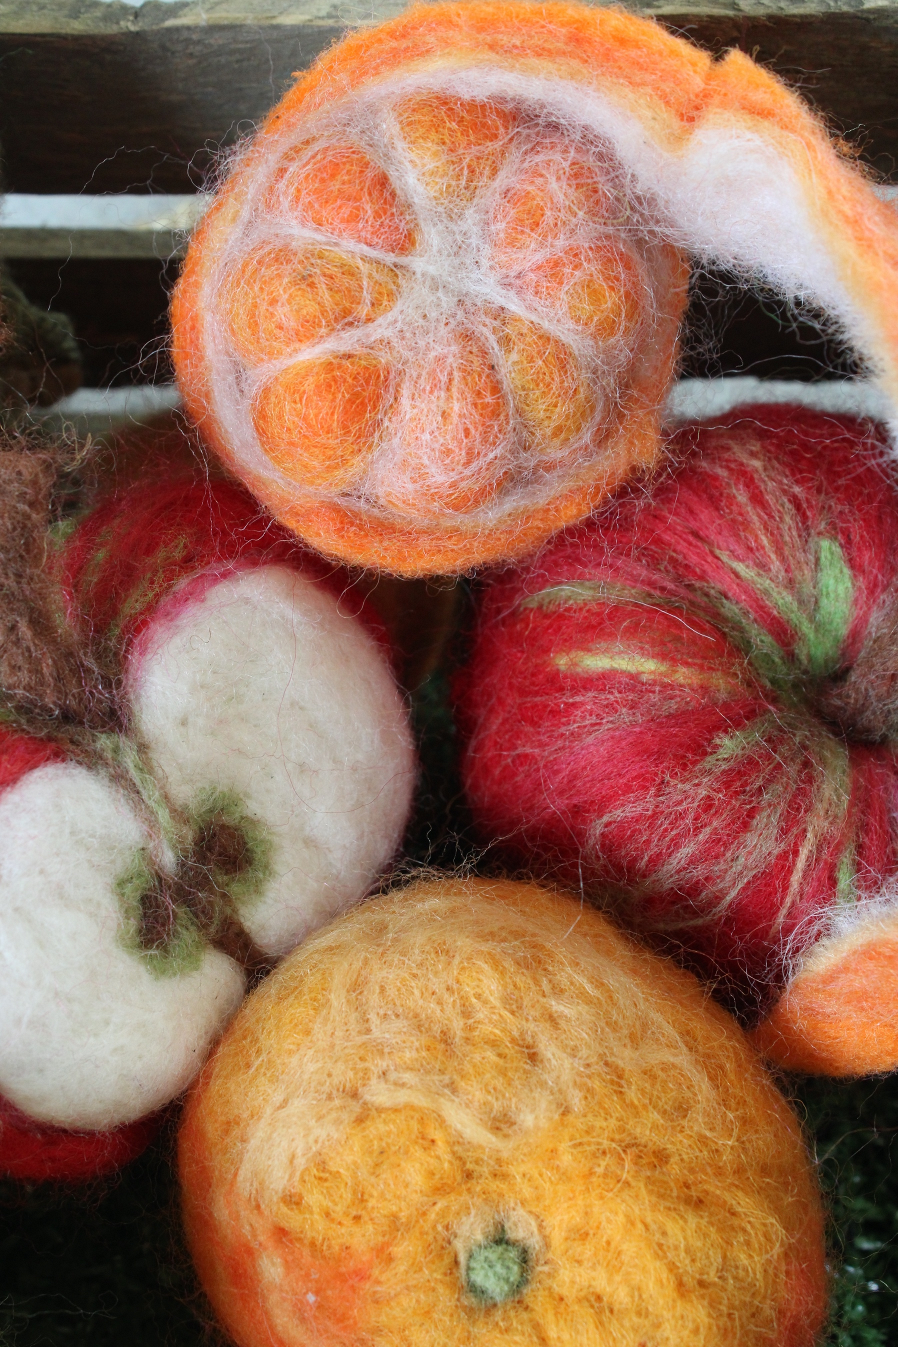
Finally…
A Level Fashion / Textile Design can be a rewarding and enriching experience that can help you develop your creativity, confidence, and knowledge.
It can prepare you for studying other creative disciplines and future careers in a wide range of fields.
It’s important to understand that this subject can be time-consuming and you will get the most out of it if you are passionate about developing your skills with textile techniques.
Many students make huge progress throughout the course, both in terms of their practical skills and their knowledge and understanding of where their work ‘fits’ in the world and how they relate to it.
We hope you’ll consider joining us!

