Slide 1
Why Study Geography at A Level?
Studying Geography at A Level provides a deeper understanding of the world and how it operates. This subject helps students explore both physical environments (like rivers, coasts, and climate systems) and human geography (such as urban development, migration, and globalisation). It's a subject that combines scientific understanding with social science, helping students to make sense of the interactions between people and the planet.
At A Level, Geography goes beyond the basics and challenges students to critically evaluate global issues such as climate change, resource management, and sustainability. It’s particularly relevant for students who are interested in environmental issues, travel, culture, politics, or understanding how the physical and human aspects of the world are interconnected.

Slide 2
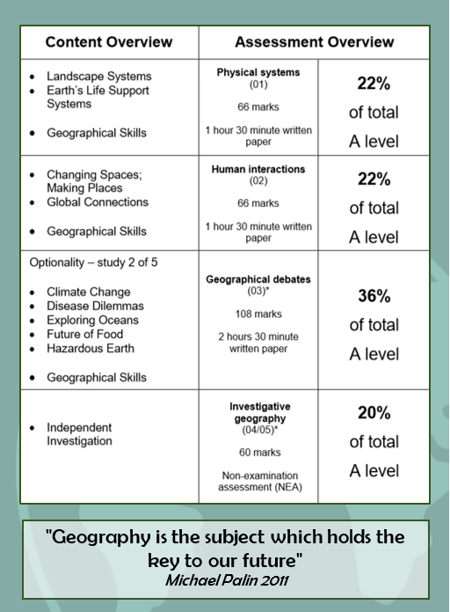
3 exams
and
one
non-examined investigation

Slide 3

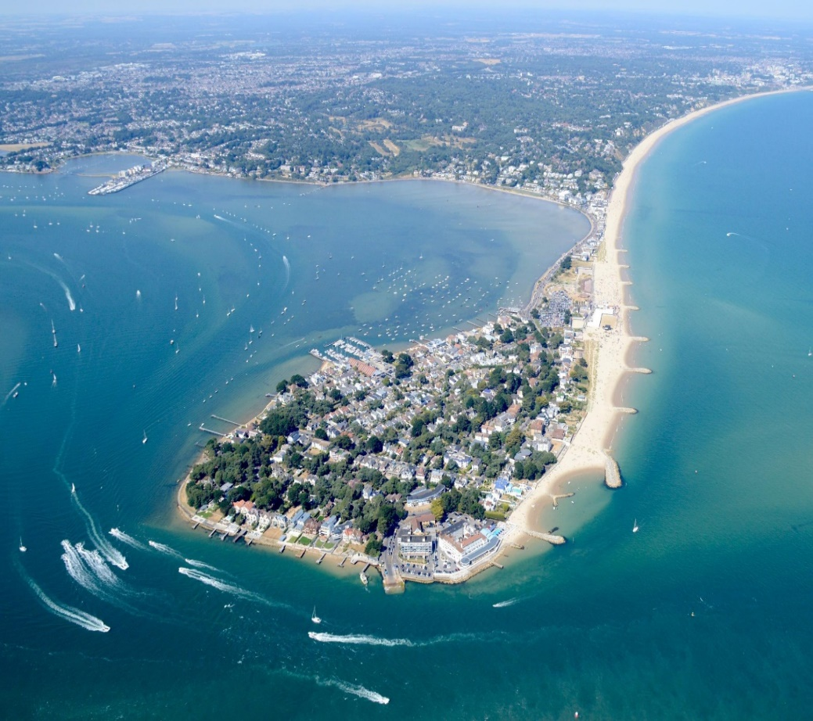
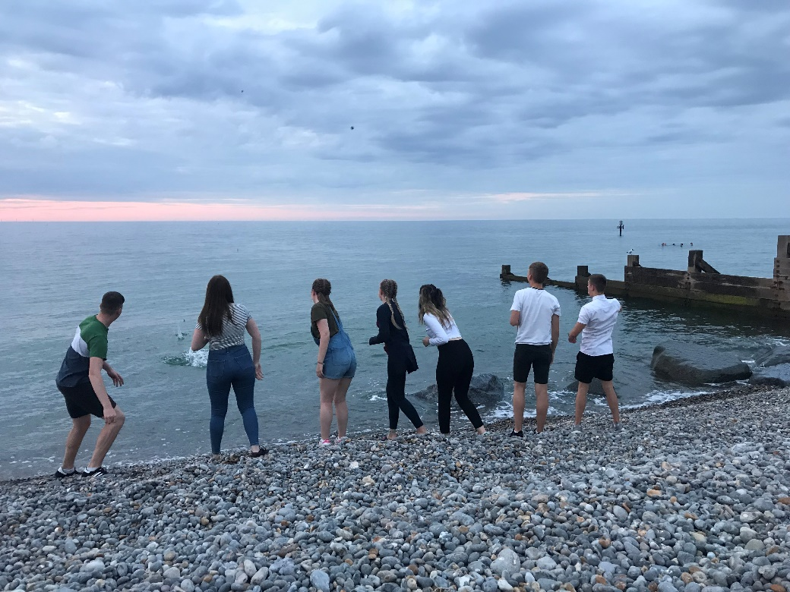
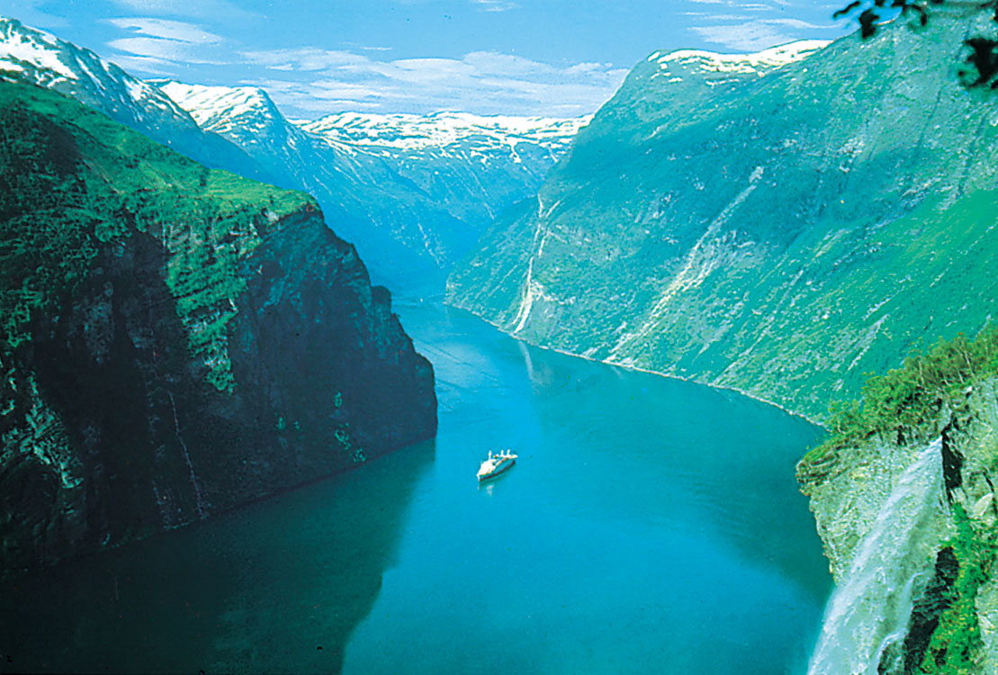
Physical Systems – Landscape Systems
Sand is just sand right? Understand the in-depth process of our coastal systems and the constantly changing landforms.
How can this glorious place be a result of human interactions with physical processes ? And with changing climates, will it soon be lost forever?
How can global climate changes flood whole valley systems and change the face of the earth?
Take your knowledge to the next level with an independent investigation focussed around changing coastal landforms.

Slide 4
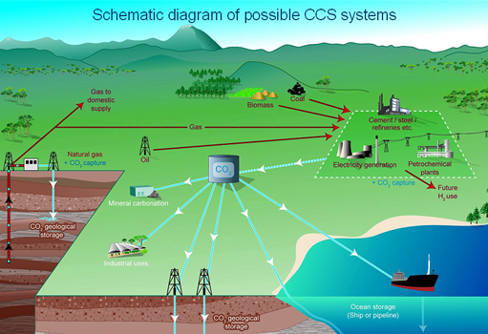
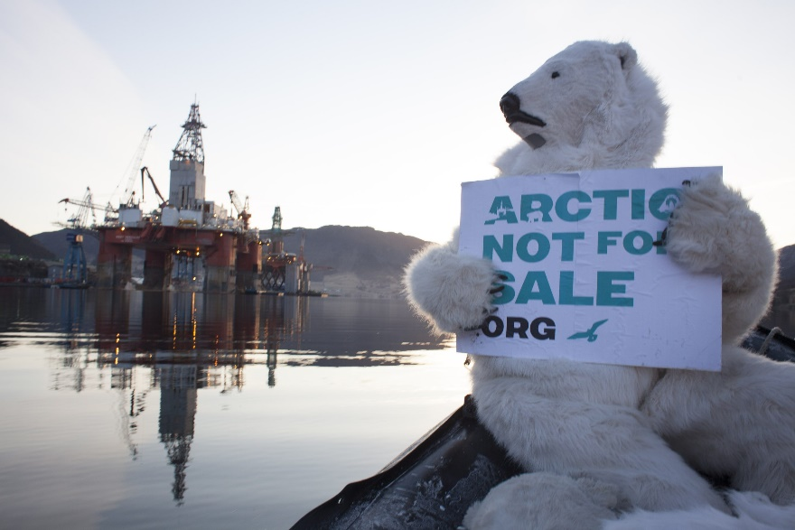
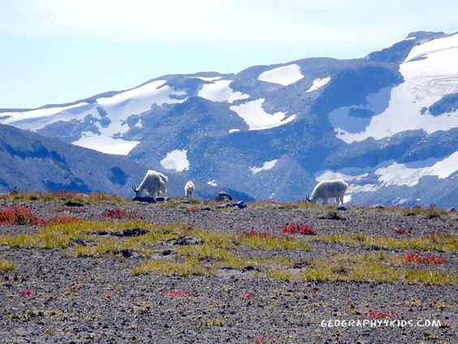
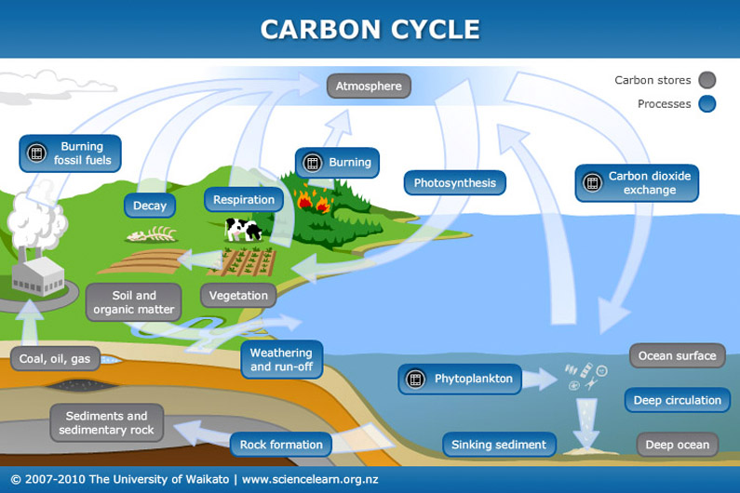
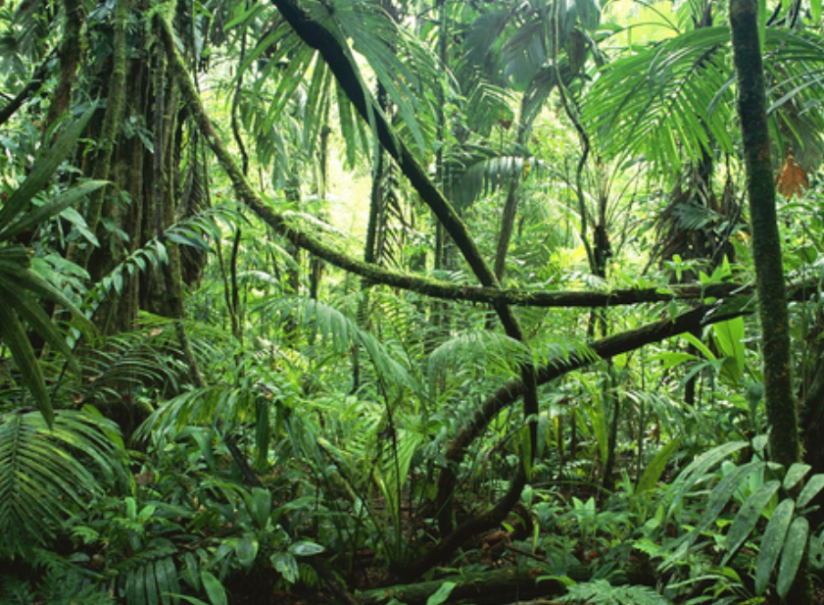
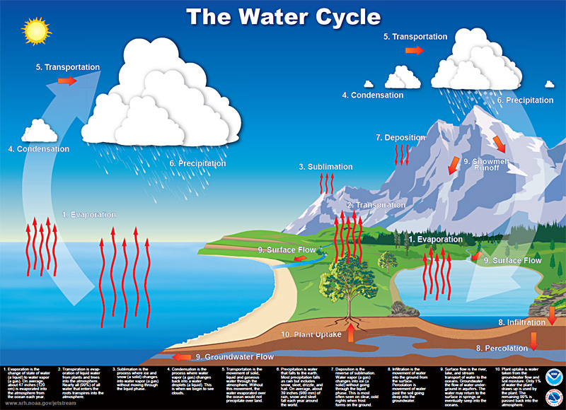
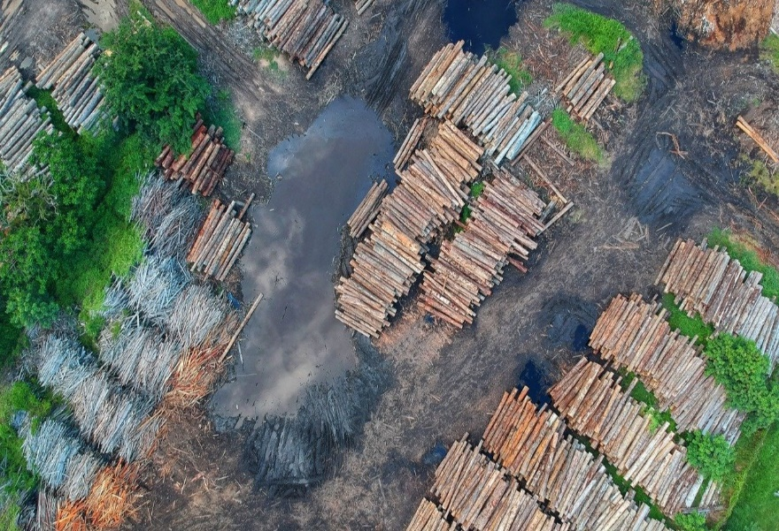
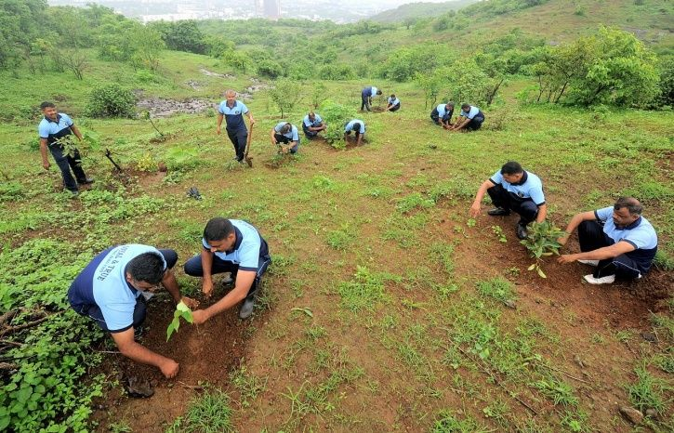
Physical Systems – Earth’s Life Support Systems
Delve deep into the two most important cycles keeping the world ticking over: the water and carbon cycles.
Discover the intricate workings of the tropical rainforest and the Arctic tundra.
Understand just how much influence humans are having on the water and carbon cycles.
Evaluate the various management strategies that can by used on various scales to reduce our impact on the two cycles.

Slide 5
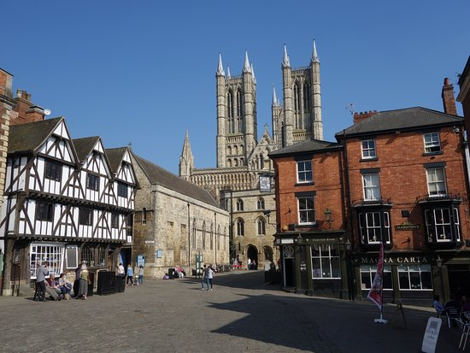
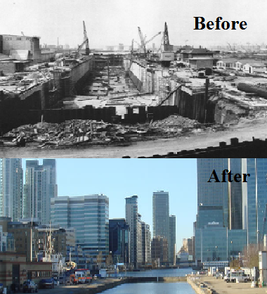
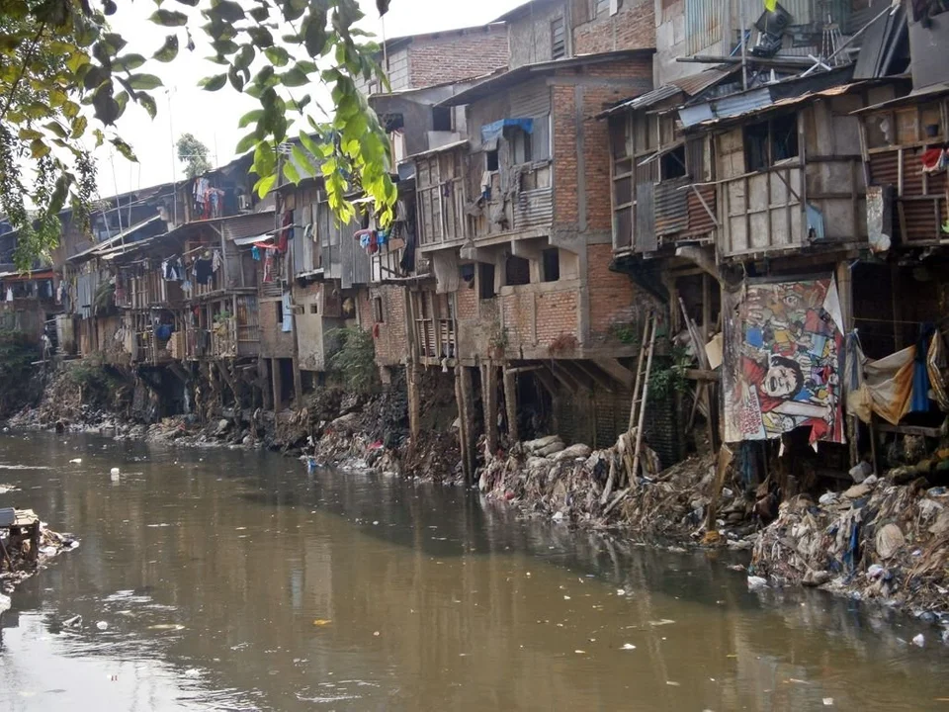
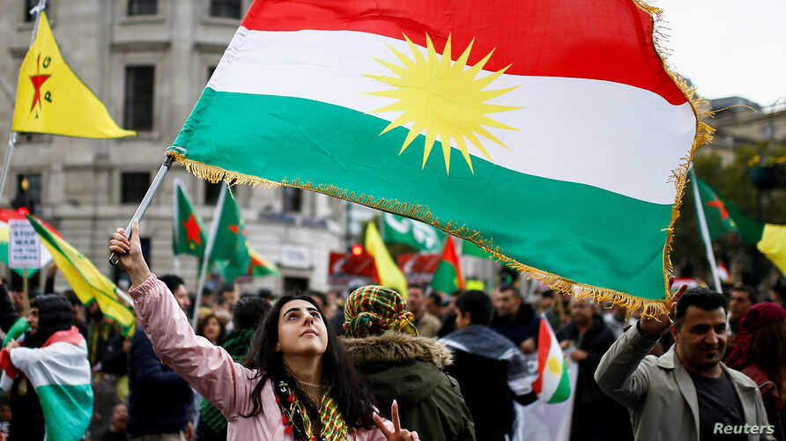
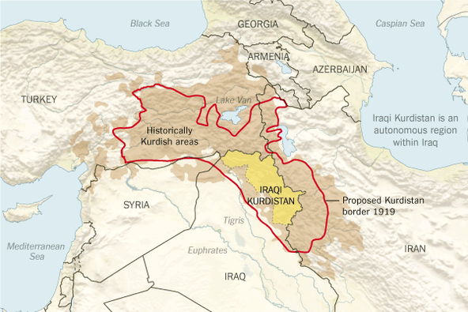

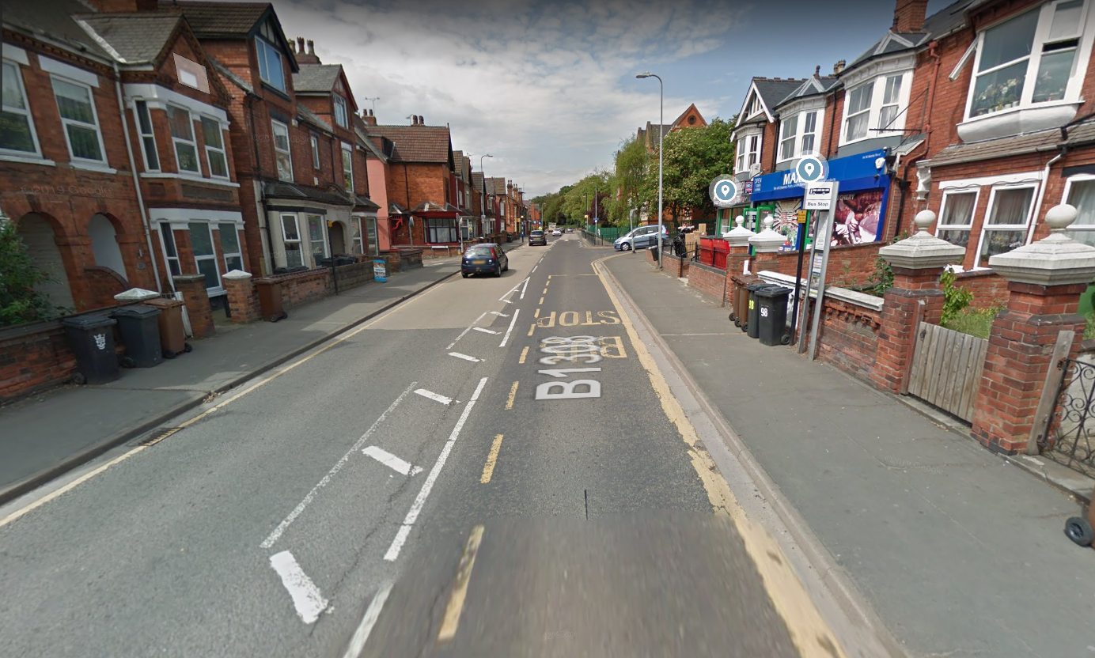
Human Interactions – Changing Spaces, Making Places
Explore the true global inequalities of wealth and health.
Discover the historical battle of one group of people, the Kurds, in their ongoing fight to remain on their land.
Assess the importance of regeneration strategies on various scales in driving economic growth.
Compare and contrast the human and physical factors that make up sense of place in areas around Lincoln.

Slide 6
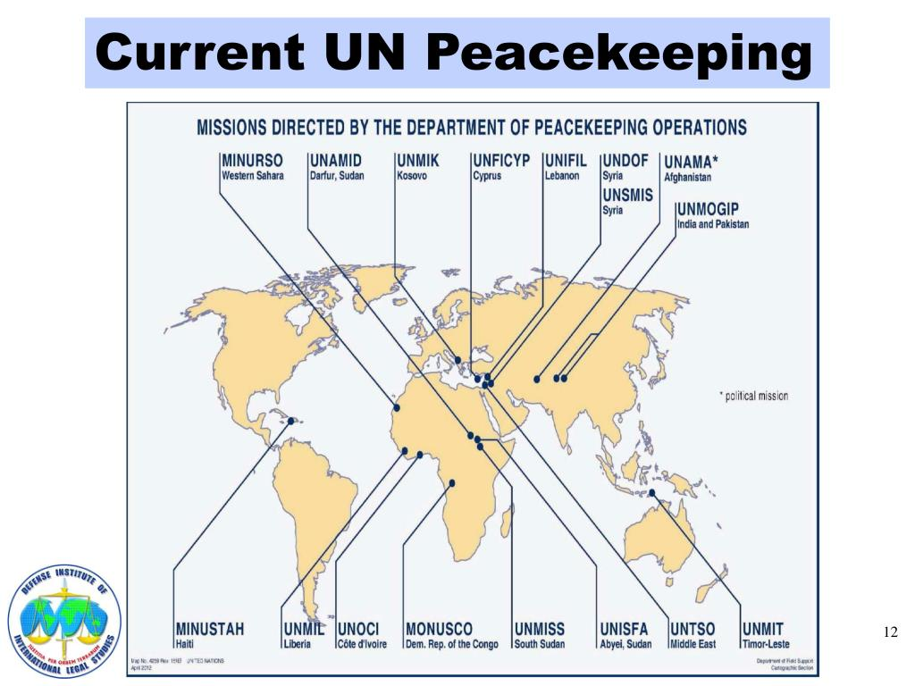
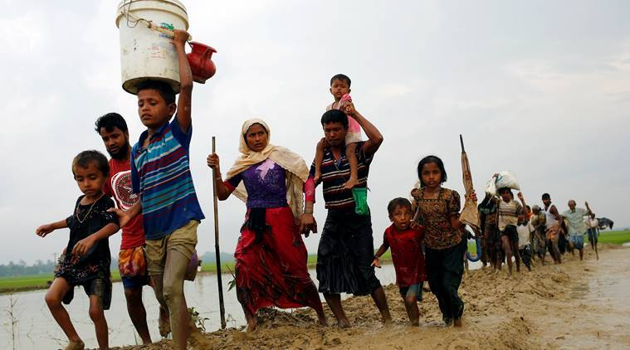
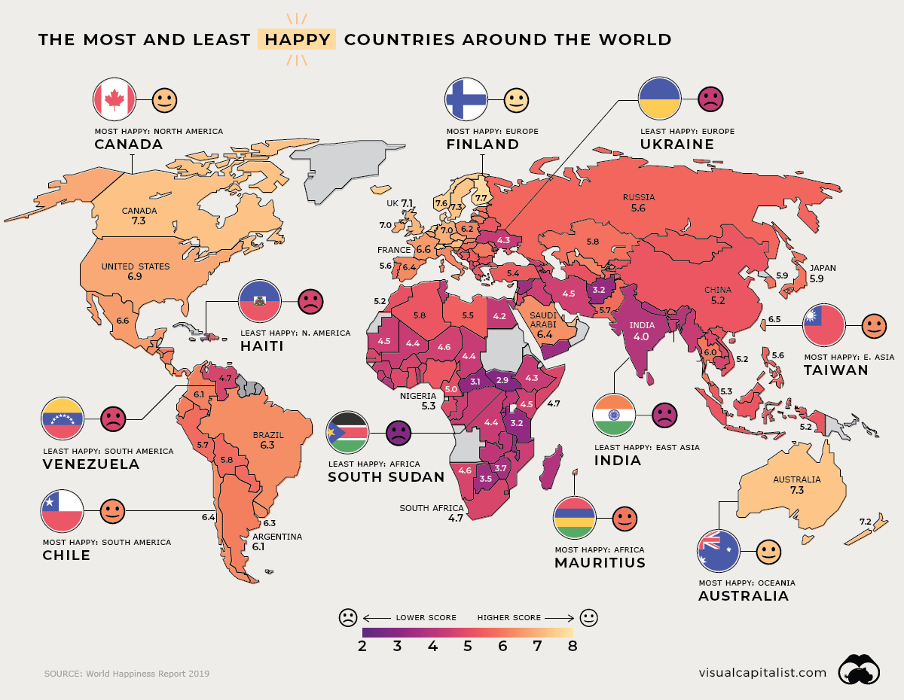
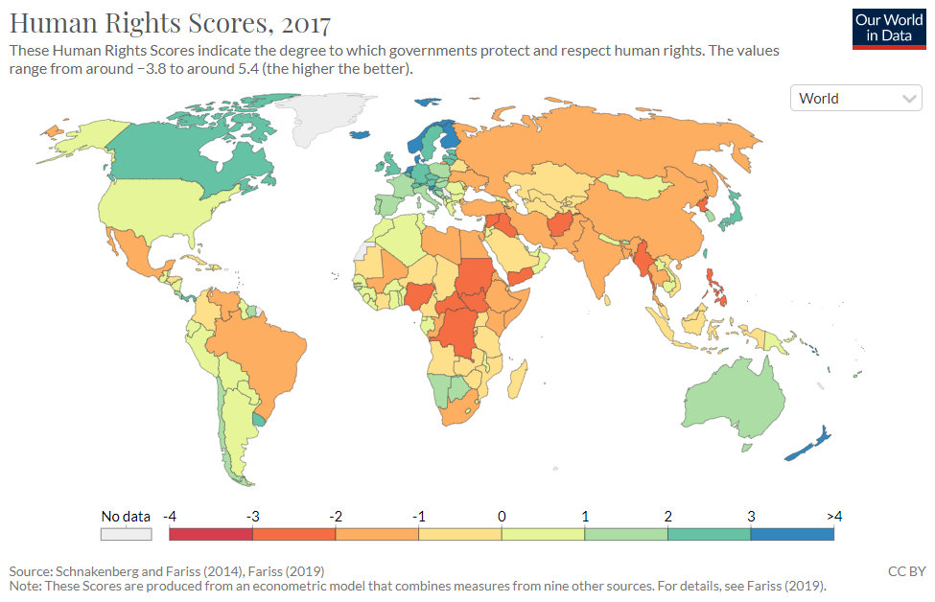
Human Interactions – Human Rights
Journey around the world to see the incredible injustices, inequalities, and inhumane practices still prevalent in many countries.
Where is the best place in the world to live? Delve into the many gender inequalities of the world.
Investigate how one repressed religion are being forced from their homes through violence and war.
Discover the incredible work being carried out by various global agencies to help those that need it most.

Slide 7
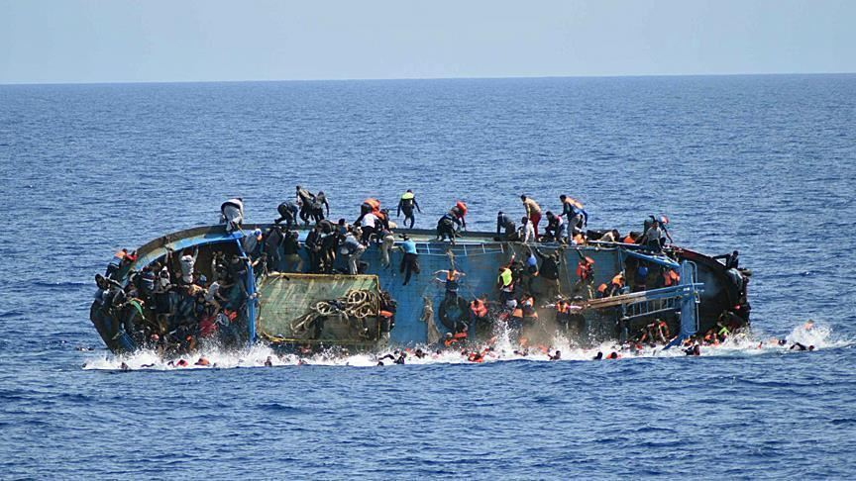

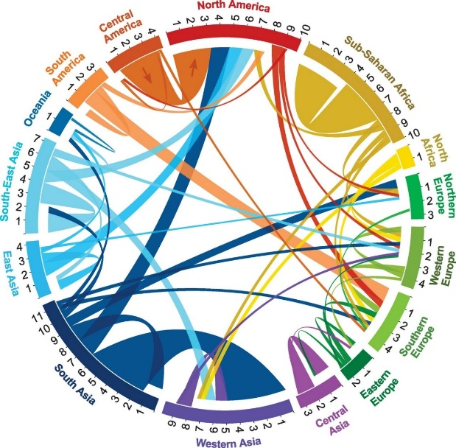
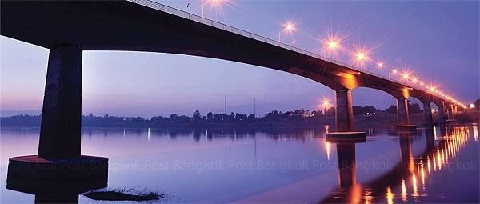
Human Interactions – Global Migration
Evaluate the every increasingly complex, interconnected and dynamic global migration patterns.
Discover the drastic lengths some migrants will go to in order to find a better life. (migrant boat pic).
Understand how some countries spend billions a year preventing migration while others actively encourage their nationals to move out!

Slide 8
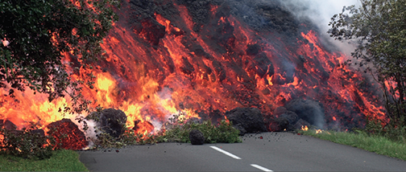
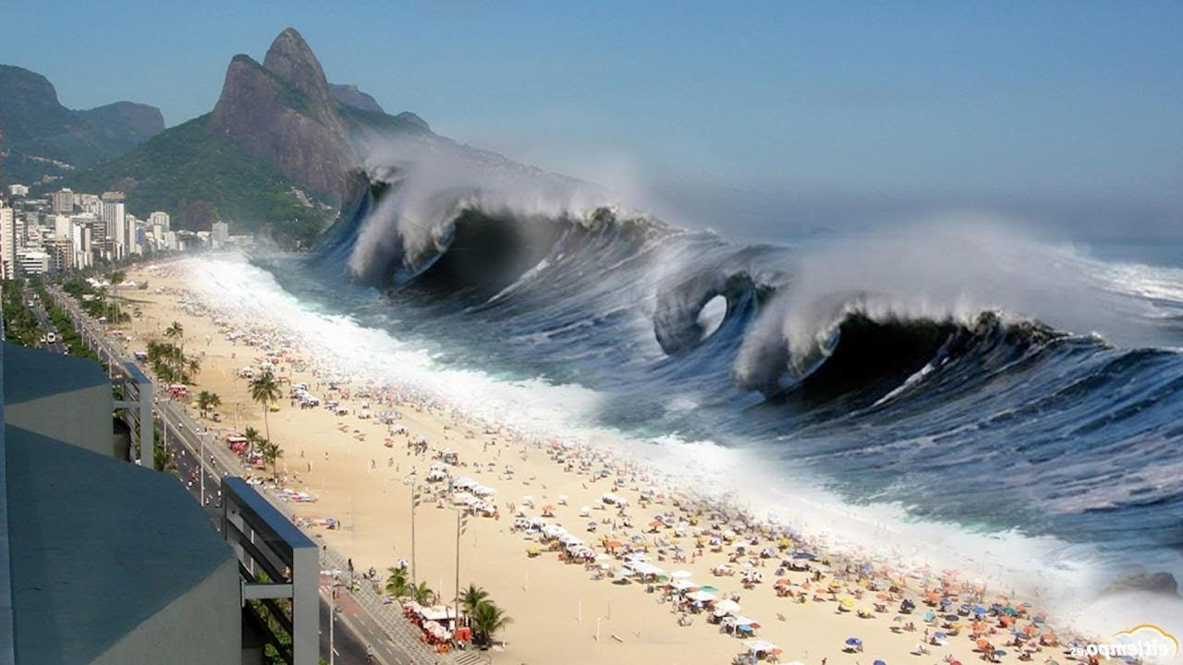
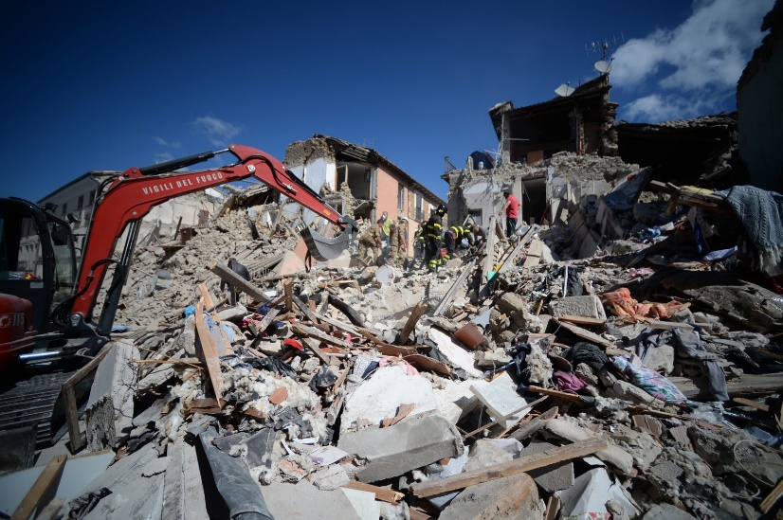
Geographical Debates –Hazardous Earth
As technology has evolved, the capacity to predict and mitigate against tectonic hazard events has improved although the impact of an event can leave communities and countries devastated.
Risks from tectonic hazards varies spatially and over time, with continued research and development there may be a point in the future when it will be possible to mitigate against the vulnerability to risk.
There are varying global levels of resilience and ability to adapt to the risks presented.

Slide 9



Geographical Debates – Disease Dilemmas
Diseases do not discriminate who becomes infected or develops symptoms. Diseases can be communicable and noncommunicable and a number of physical and human factors affect an individual’s and community’s susceptibility to the risk.
The global nature of some diseases in terms of their geographical spread and scale has encouraged international efforts to combat them.
The causes of disease are often complex and the impacts even more so especially when dealing with these at epidemic and pandemic levels.

Slide 10
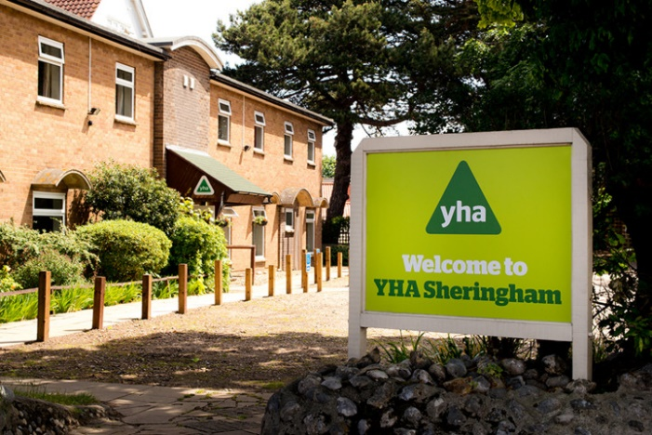
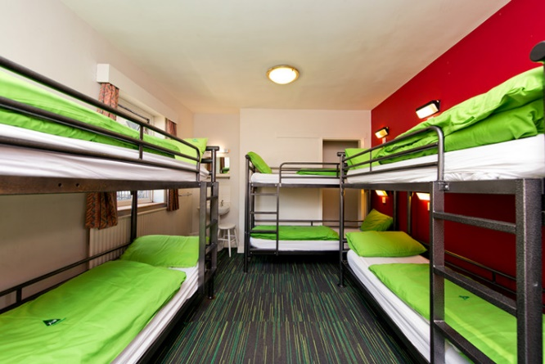
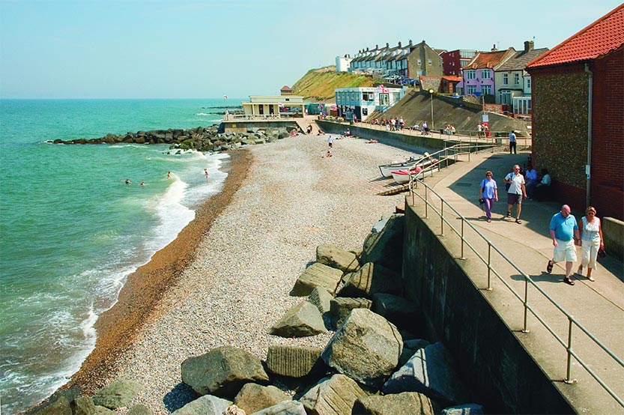
Independent Investigation -NEA
An independent investigation in A Level Geography provides learners with the opportunity to develop a wide range of skills and abilities which are applicable not only to study in Higher Education but also within the world of work and life, which, amongst others, include:
the structure and enquiry process;
extended writing;
innovation in investigating and presenting data;
self-directed study;
research techniques;
making synoptic links between the real world, geographical theory, the learners own research and the specification.

Slide 11
Skills you learn in A Level Geography
Analytical skills: Geography involves interpreting data, maps, graphs, and case studies. You learn how to break down complex information and analyse geographical patterns and trends.
Critical thinking: You’ll evaluate environmental, social, and political problems, develop arguments, and propose solutions to issues such as urbanization, deforestation, and climate change.
Research skills: Geography students develop strong research skills through case studies and fieldwork, including collecting data, conducting surveys, and analysing geographical phenomena.
Problem-solving: You will address real-world issues, such as how to manage natural disasters or develop sustainable urban spaces, honing your ability to think strategically and find solutions.
Technical skills: A Level Geography often involves the use of geographical information systems (GIS) and other mapping tools, which are increasingly important in the modern job market.
Communication and writing: Students improve their ability to write reports, present findings, and communicate complex ideas clearly.
Teamwork and collaboration: Fieldwork often requires working in groups, building skills in cooperation and leadership.

Slide 12
What jobs could an A Level in Geography lead to?
Environmental consultant: Working on projects related to sustainability, conservation, pollution control, and environmental regulations.
Urban planner: Helping to develop towns and cities, considering factors like infrastructure, transport, housing, and environmental impact.
Geographical Information Systems (GIS) Analyst: Using GIS software to analyse spatial data and produce maps and models for sectors like agriculture, urban planning, or environmental management.
Cartographer: Specialising in creating maps and visual representations of data.
Meteorologist: Studying and predicting weather patterns and climate changes.
Disaster and emergency manager: Planning for and managing responses to natural disasters such as floods, hurricanes, and earthquakes.
International development worker: Contributing to projects in developing countries, focusing on areas like sustainability, education, or infrastructure.
Conservationist or ecologist: Working on wildlife conservation projects, protecting ecosystems, or advising on environmental policies.
Travel and tourism consultant: Using your geographical knowledge to promote sustainable tourism or manage tourism destinations.
Teaching or lecturing: Becoming a Geography teacher or academic at a school, college, or university.

Slide 13

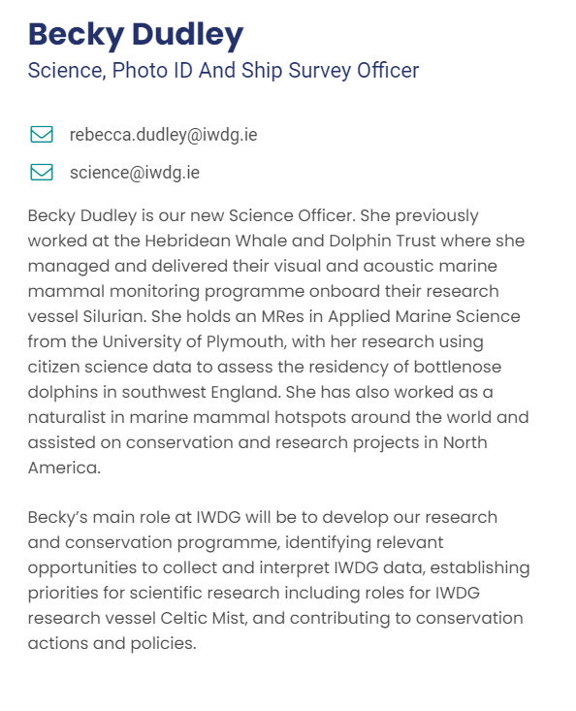
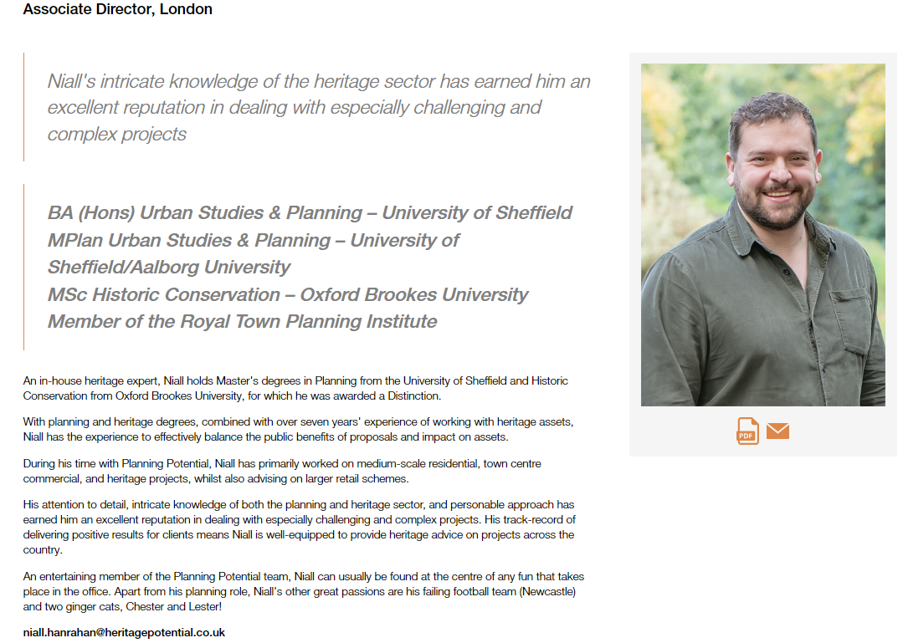
Past LCHS Geography students
Studied A Level Geography, the same year as Mrs Gelder

