Slide 1

STUDIES

Slide 2


MEDIA STUDIES
production
Think you know media?
identity
analysis
society
gender
ideology
harm
influence
feminism

Slide 3

Media Studies – the study of mass communication and its influence – offers a vitally important opportunity to question the world around us. It is the point where communication, culture and technology meet (to quote UCAS!) and a chance to consider the forces that shape both ourselves and our world view.

Slide 4

In the past, Media Studies has been viewed as non-vocational or lacking academic rigour. Neither could be further from the truth.
Media Studies is a demanding, theory-driven subject requiring insight, creativity, media literacy, emotional intelligence and organisation.
A recent study by the London-based British Academy described Media Studies as a dynamic subject valued by universities where it is increasingly popular, and one which plays a key role in this country’s £100+ billion creative industries.

Slide 5

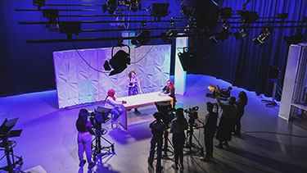
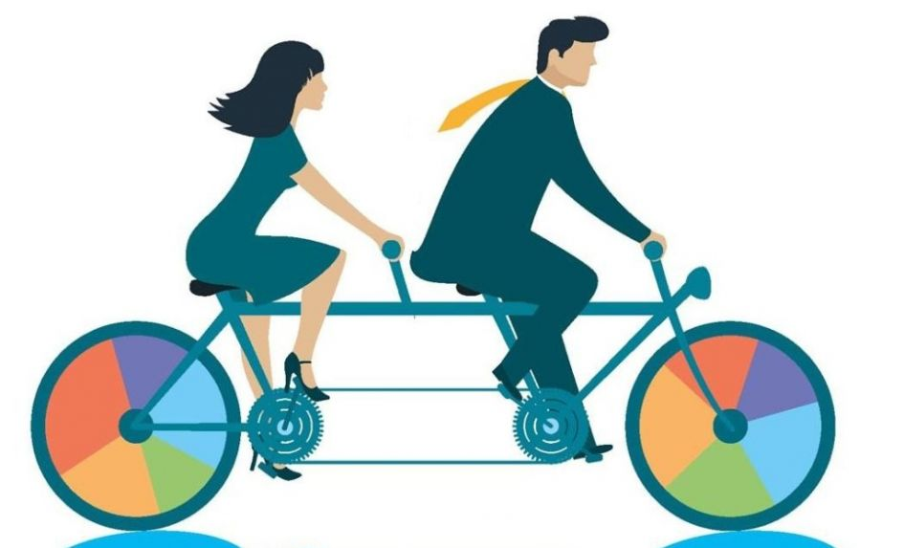
Media Studies can open doors to countless careers and opportunities.
It can move you towards anything from journalism or moving image production and all its associated careers – including fashion, photography, special effects, etc - to digital, social media or web-based roles, as well as radio, careers in gaming, game design and game production, PR and advertising, publishing, CGI and photography, and so much more.

Slide 6
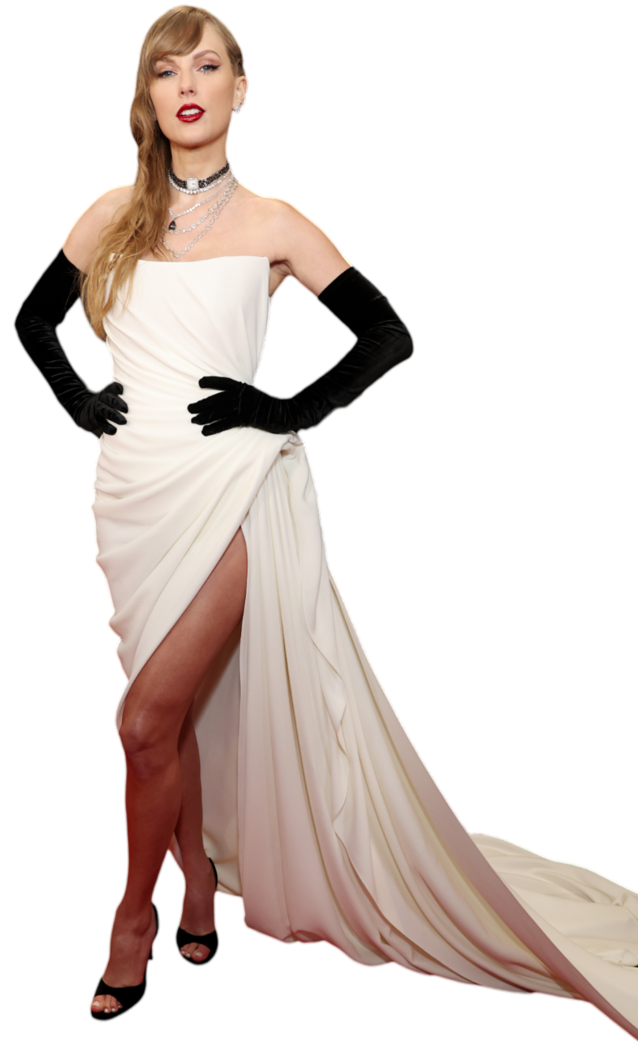
The course is built around a series of set texts called Close Study Products. These are chosen by the exam board and encompass film, TV and radio, the internet, social media and online influencers, advertising, music video, magazines and newspapers.
In 2024, that includes everything from classic Danish thriller The Killing and game favourite Horizon Forbidden West to L’il Nas X’s Old Town Road video and the online presence of Taylor Swift.

Slide 7
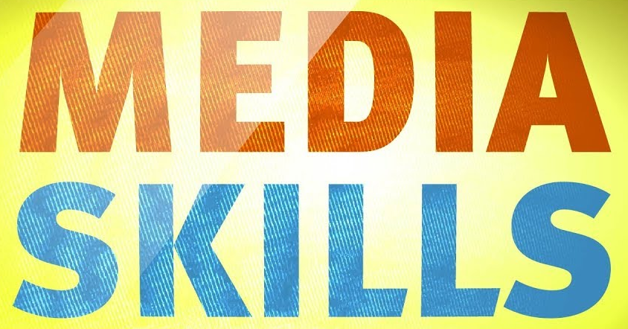
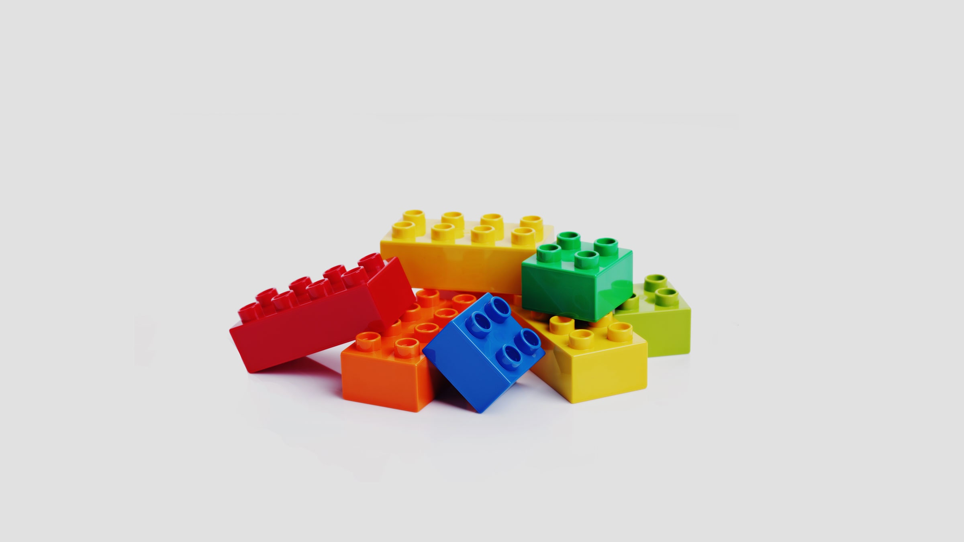
Throughout the course you will develop your abilities in:
analysis and deconstruction;
critical thinking;
essay writing;
using subject-specific terminology;
understanding media theory;
questioning;
media production;
discussion and debate;
media literacy;
independent learning.

Slide 8
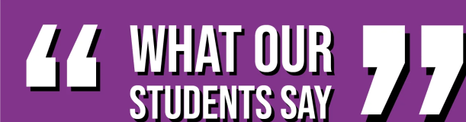

“You definitely won’t be able to view the media the same after the course.”
“It helped me develop crucial skills such as critical thinking and analysis.”
“Media Studies is a great subject that lets you explore how the media influences both public and private lives.”
“Even if you don’t want to take a path for media, the skills you learn can be applied to many everyday things.”
“It is important for my choice (forensic psychology) at university.”
“I really like this course. It’s been super informative and I have learned lots of new and interesting things. In want to do international relations at university and this course will really help me to do that.”
“It gives students insights into the industries and media which they will consume for the rest of their lives.”
“The course gives you a whole new view on how the media runs our lives. It will change you view on everything.”

Slide 9
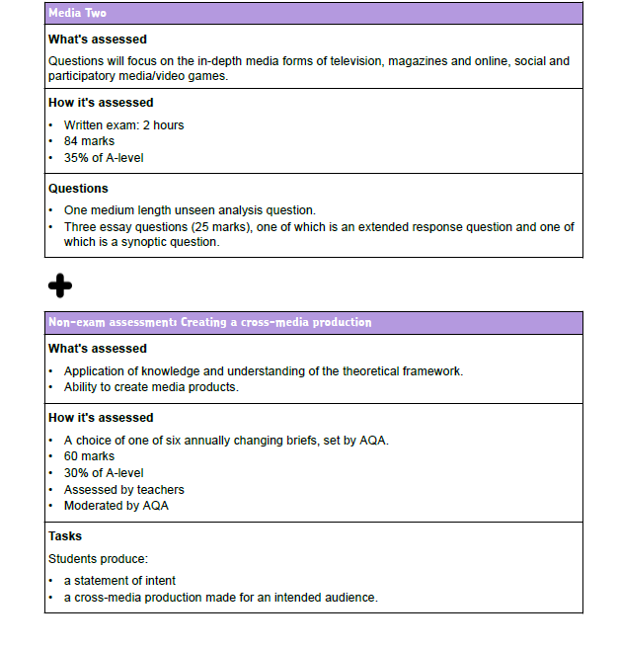
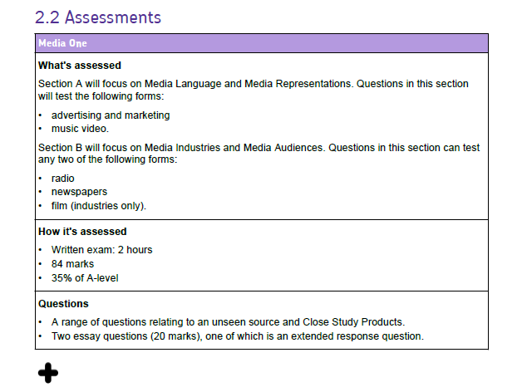
The course concludes with two examinations – details on this slide – along with two linked pieces of coursework which account for 30% of your overall grade.

Slide 10


Media shapes you.
Media shapes your world.
For more details, speak to Mr Lyon in the English department
Media Studies helps you understand how.

