Slide 1
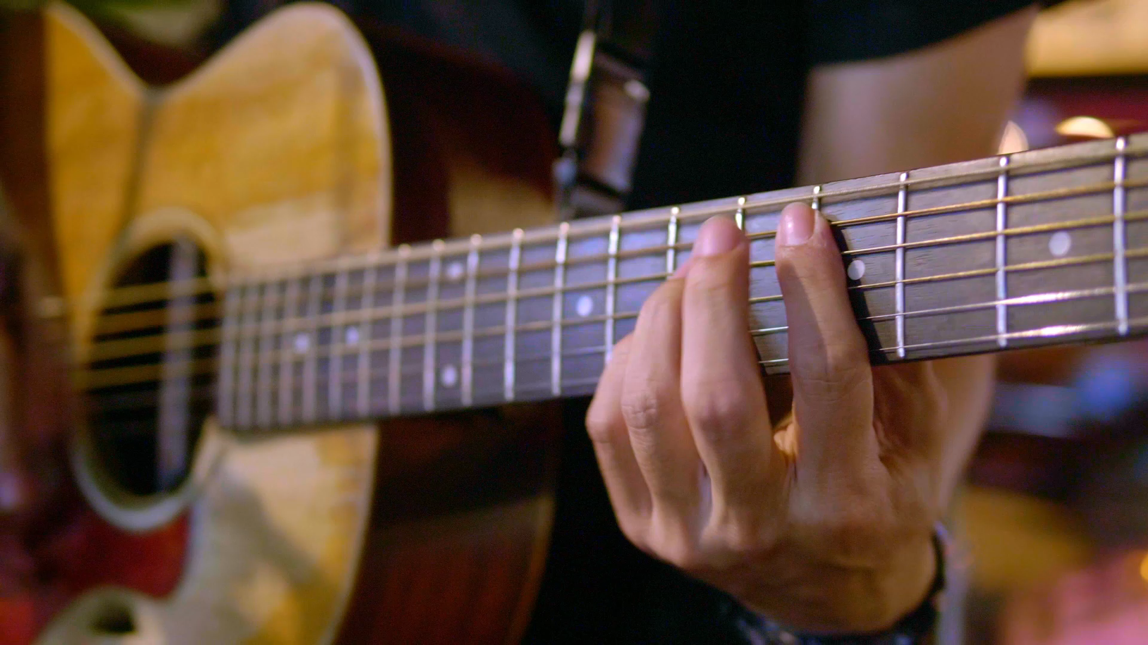

Eduqas
A Level Music
Lincoln Christ’s Hospital School

Slide 2
Course
Appraising exam – 40%
Performance 35/25%
Composition 25/35%
By studying Eduqas A Level Music, you get to choose your weighting for performance and composition for what suits you best!
Ideally, you will want to be working towards or have already achieved Grade 5 theory and by Y13 be a minimum of grade 6 on your instrument.

Slide 3
Overview
Interesting areas of study include the Development of the Symphony; a choice of Rock and Pop Music, Jazz, or Musical Theatre; either Into the Twentieth Century or Into the Twenty-First Century. The Area of Study “Into the Twenty-First Century” includes works by living male and female composers giving an insight into the current music industry.
There is a symphony to study as a set work, and two short twentieth or twenty-first century pieces, but beyond this the choice of classroom repertoire is left to the teacher who will select music which is relevant to their teaching points and which will be interesting and accessible to the learners in their class.
Performing is assessed by a visiting examiner, giving a much more realistic scenario than a recording, allowing students to demonstrate their communication of the music to the listener, and giving a real sense of occasion.
Composition is assessed through two pieces: one written in a Western Classical Style in response to a chosen brief, and one free piece which can be in any genre, allowing candidates to demonstrate and develop their personal style.
Students can choose whether they wish to be assessed on a longer performance or submit a third composition, allowing them to develop their preferred specialism.

Slide 4
Why study music?
Music is not just a practical subject. Of course, it is fun! However, A-Level Music is a rigorous academic subject which sets students up well for university study, and universities are aware of this;
Studying Music involves written, analytical, practical and social/personal skills such as independent learning, team working, performance and presentation skills, listening, and essay-writing skills. All whilst personally developing confidence, self-esteem, creativity and self-expression;
Making music can help a young person maintain good mental health during a time of high pressure and anxiety.

Slide 5
Skills
Self-discipline;
Critical thinking;
Problem solving;
Research;
Essay writing;
Appraising;
Performing;
Composing.

Slide 6
Where can it lead to?
Music A Level can lead to further musical study at degree level. However, the skills you develop through studying music, such as self-discipline, cooperation and high level analysis skills, are greatly valued on all degree courses and by employers.
A level Music is a highly regarded subject, either alongside other creative courses or in demonstrating a broader range of skills next to Science, Maths or other non-creative subjects.
Whilst Music can be a useful subject for Arts and Media courses at university, the most obvious degree pathway is going on to a degree in Music, which can lead to a range of exciting career options, including becoming a professional musician, a sound technician, a music therapist, a teacher, or a private tutor. Jobs that are less directly related a Music degree, but where a Music degree could be very valuable include arts administration, and work in radio, theatre and events management.

Slide 7
Final thoughts
Music is fun, music is tough, music is rewarding.

Slide 8
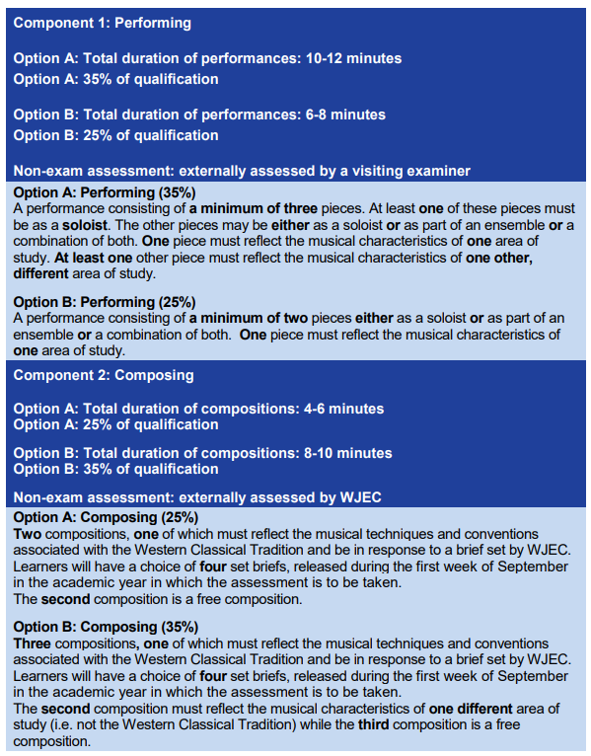
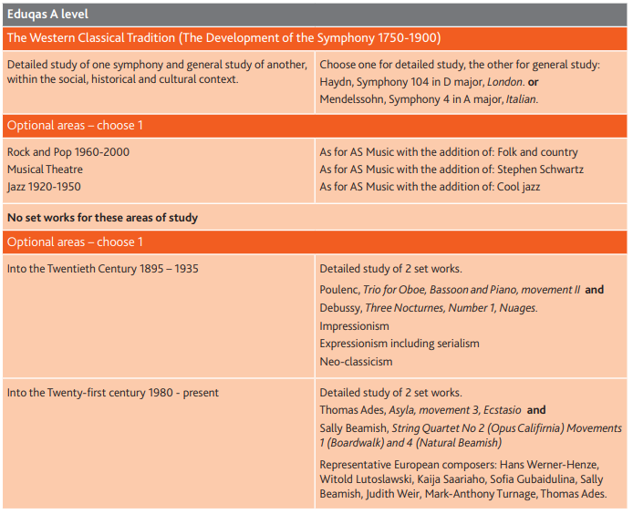
Assessment specification

